Slide 1
Text Mining Final Presentation
Sean Graham

Slide 2
Intro
You are a data scientist in healthcare. Your manager gives you two Coronavirus tweets datasets. The training dataset contains in the file Corona_NLP_train.csv. The test dataset contains in the file Corona_NLP_test.csv. Both have the following columns:
UserName
ScreenName
Location
TweetAt
OriginalTweet
Sentiment

Slide 3
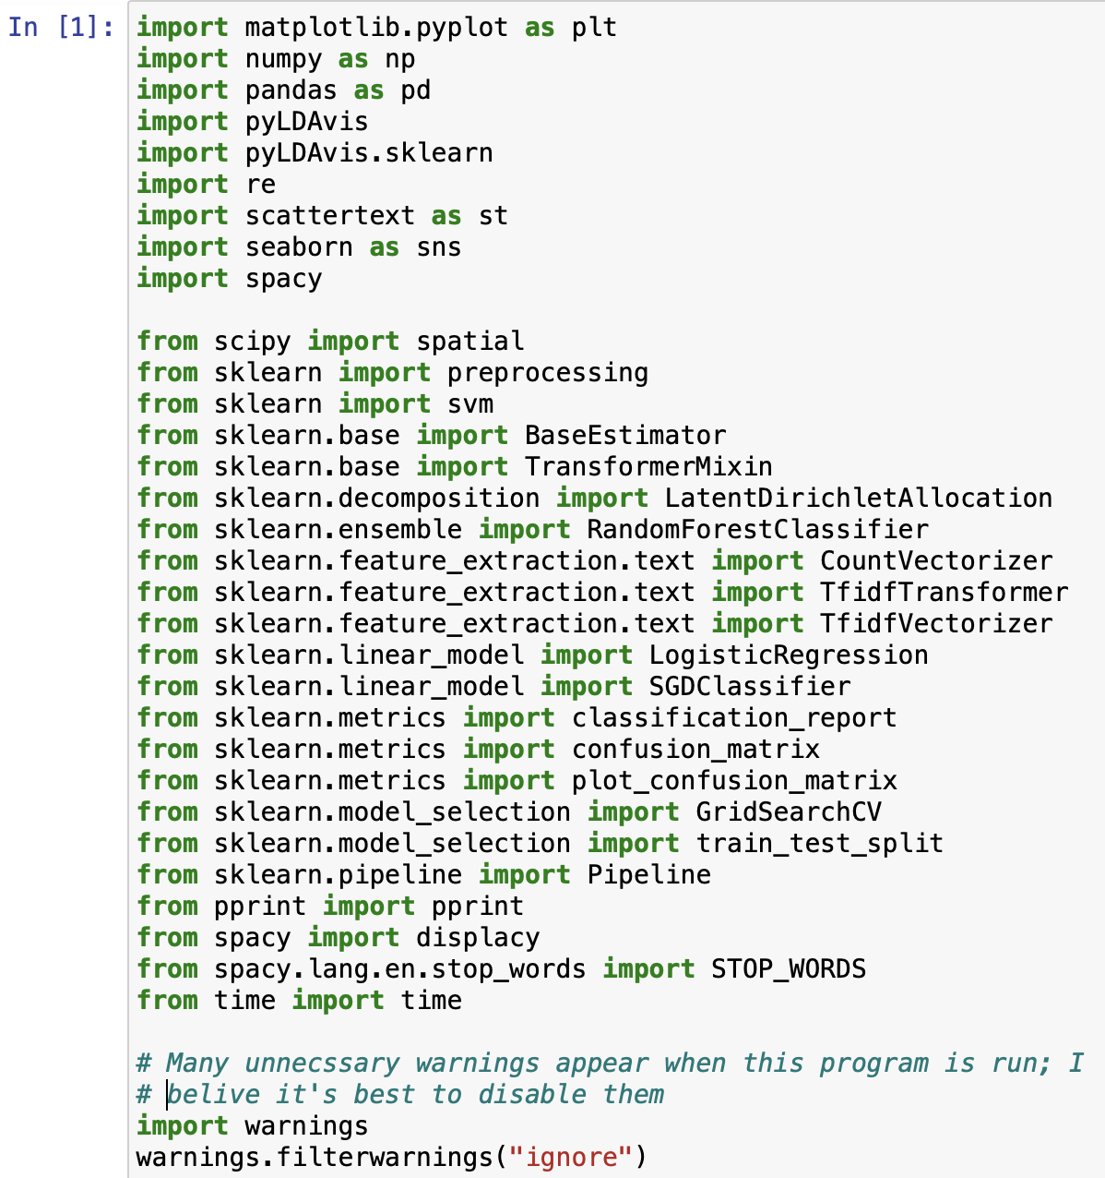
Import Necessary Items

Slide 4
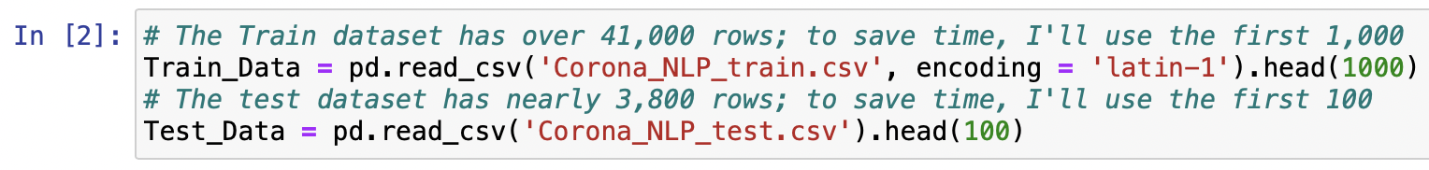
Import Datasets

Slide 5
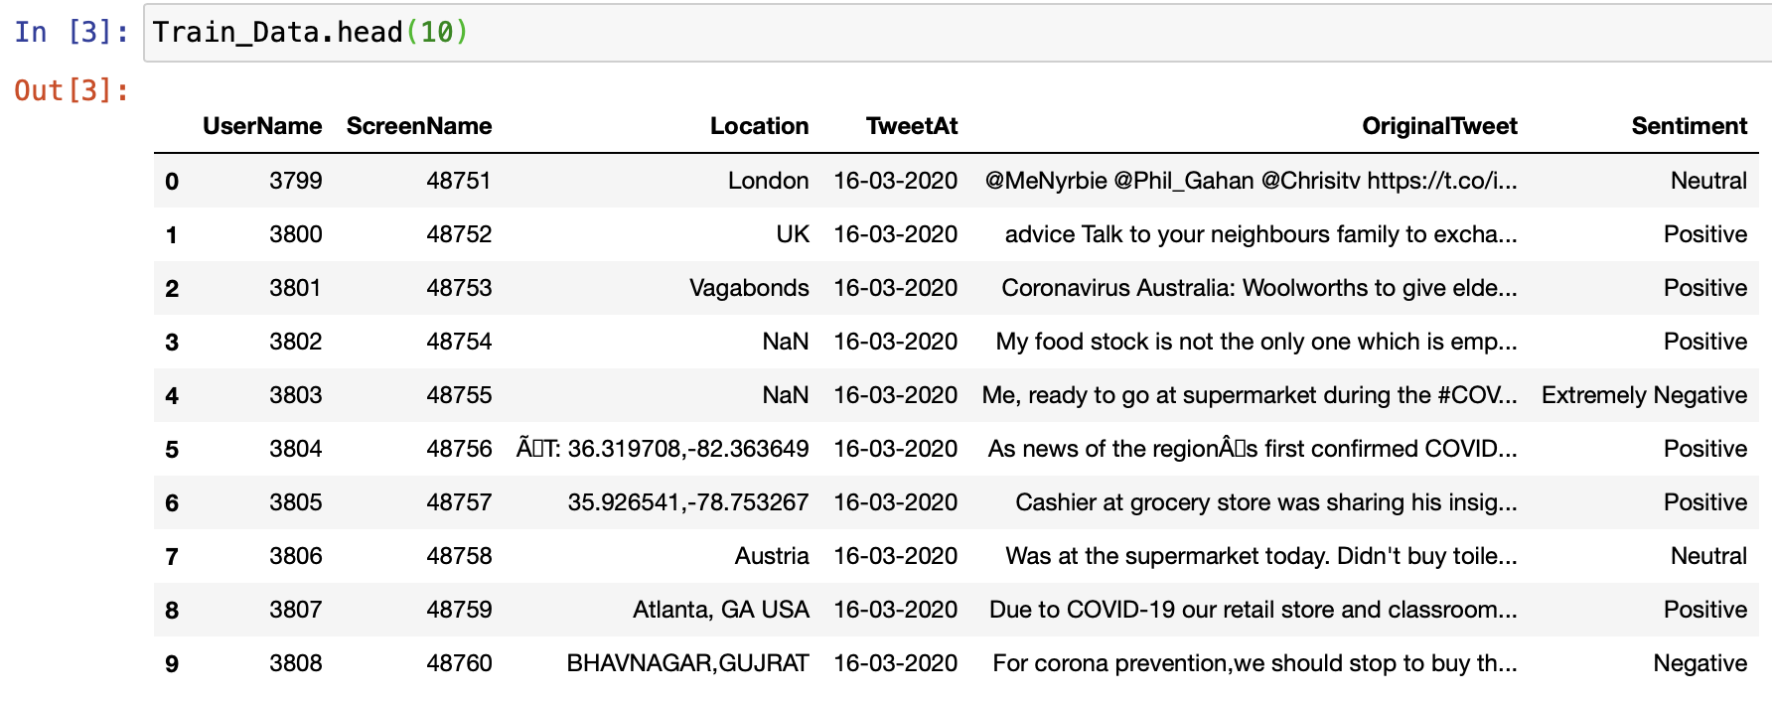
Display Train Data

Slide 6
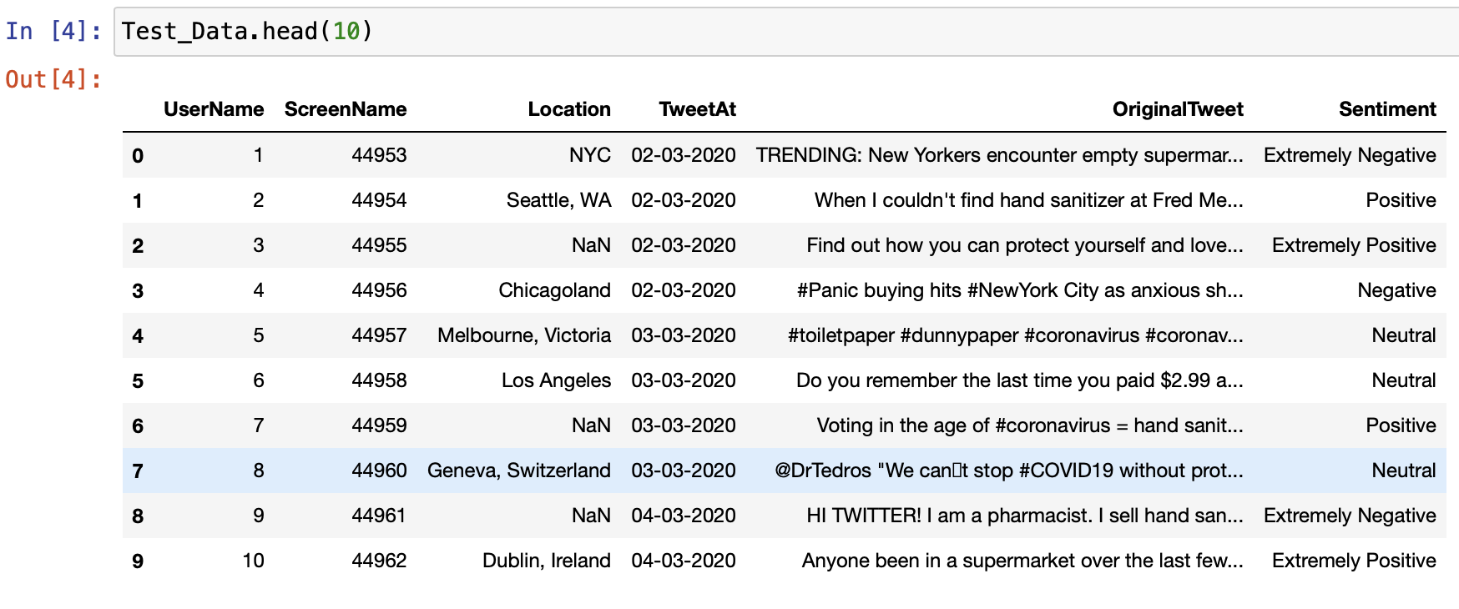
Display Test Data

Slide 7
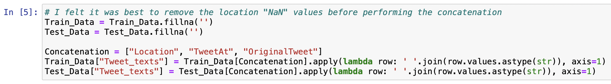
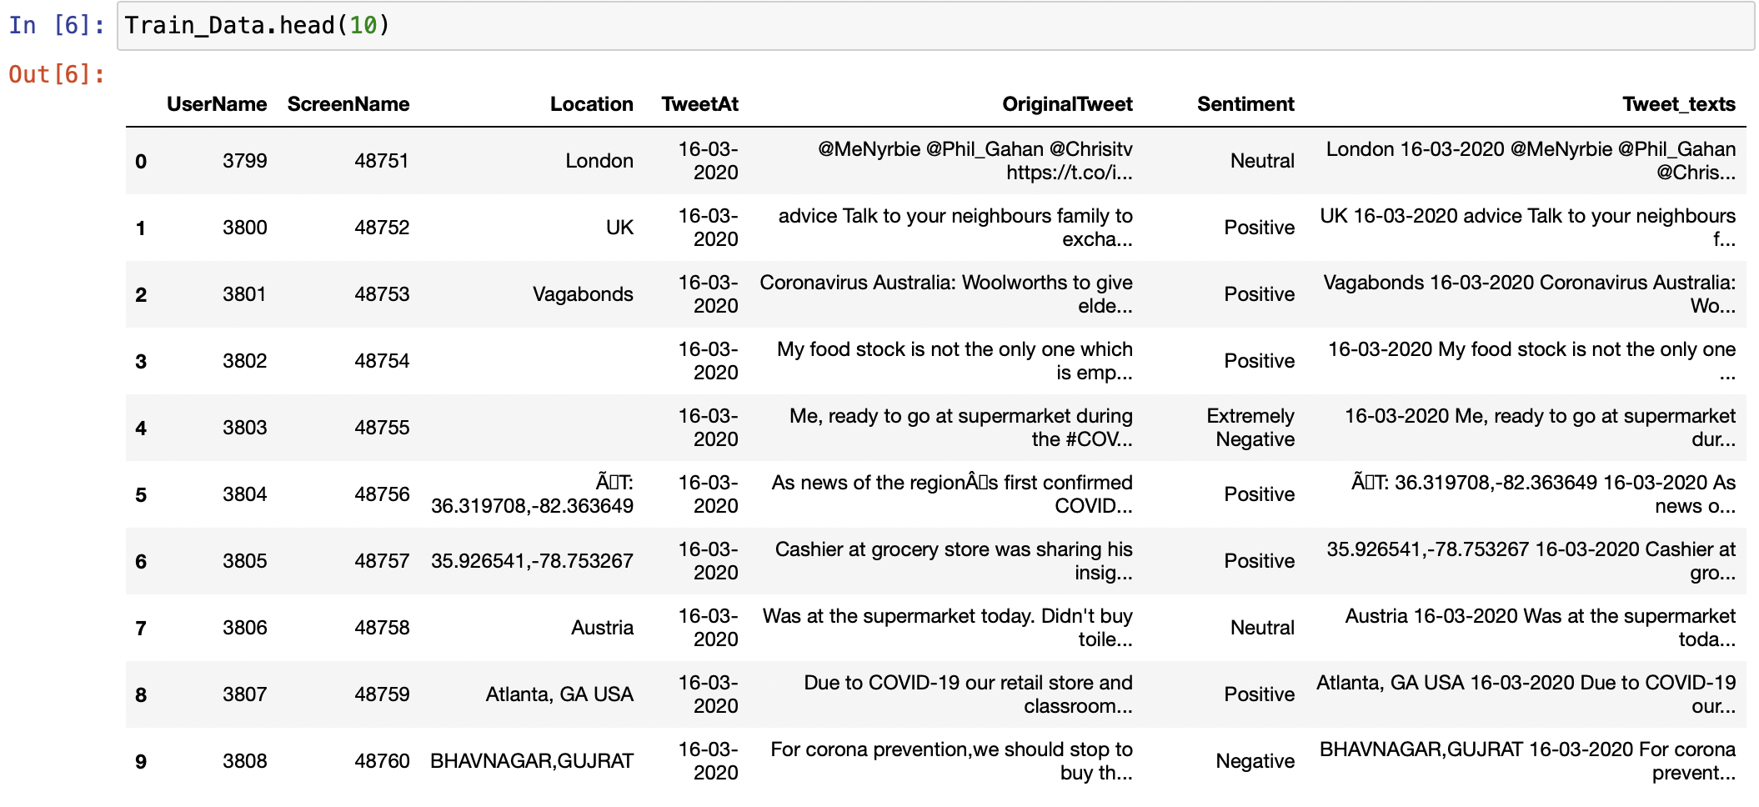
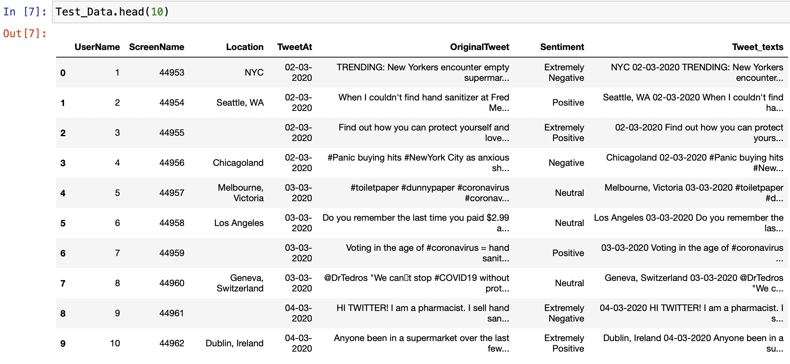
1. Concatenate the following three columns into a new column of Tweet_texts: - Location - TweetAt - OriginalTweet

Slide 8
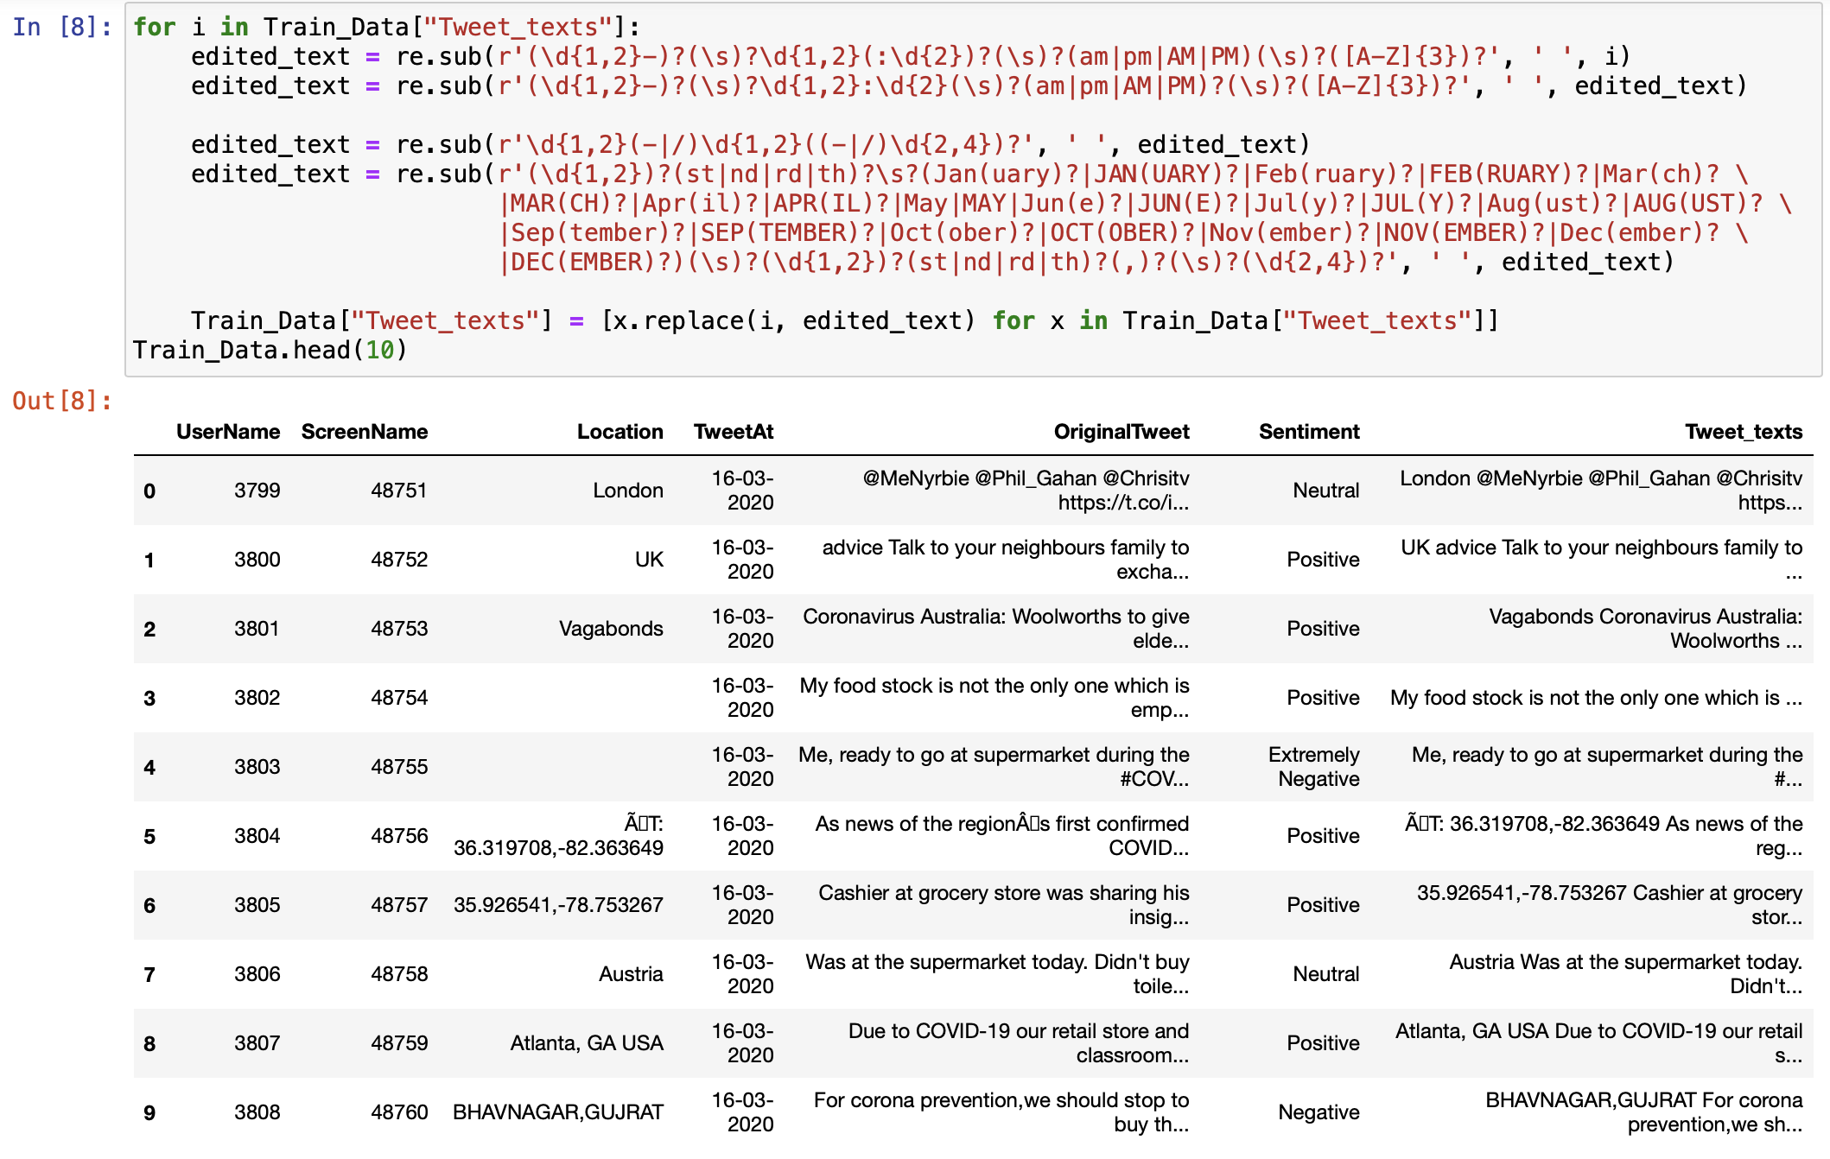
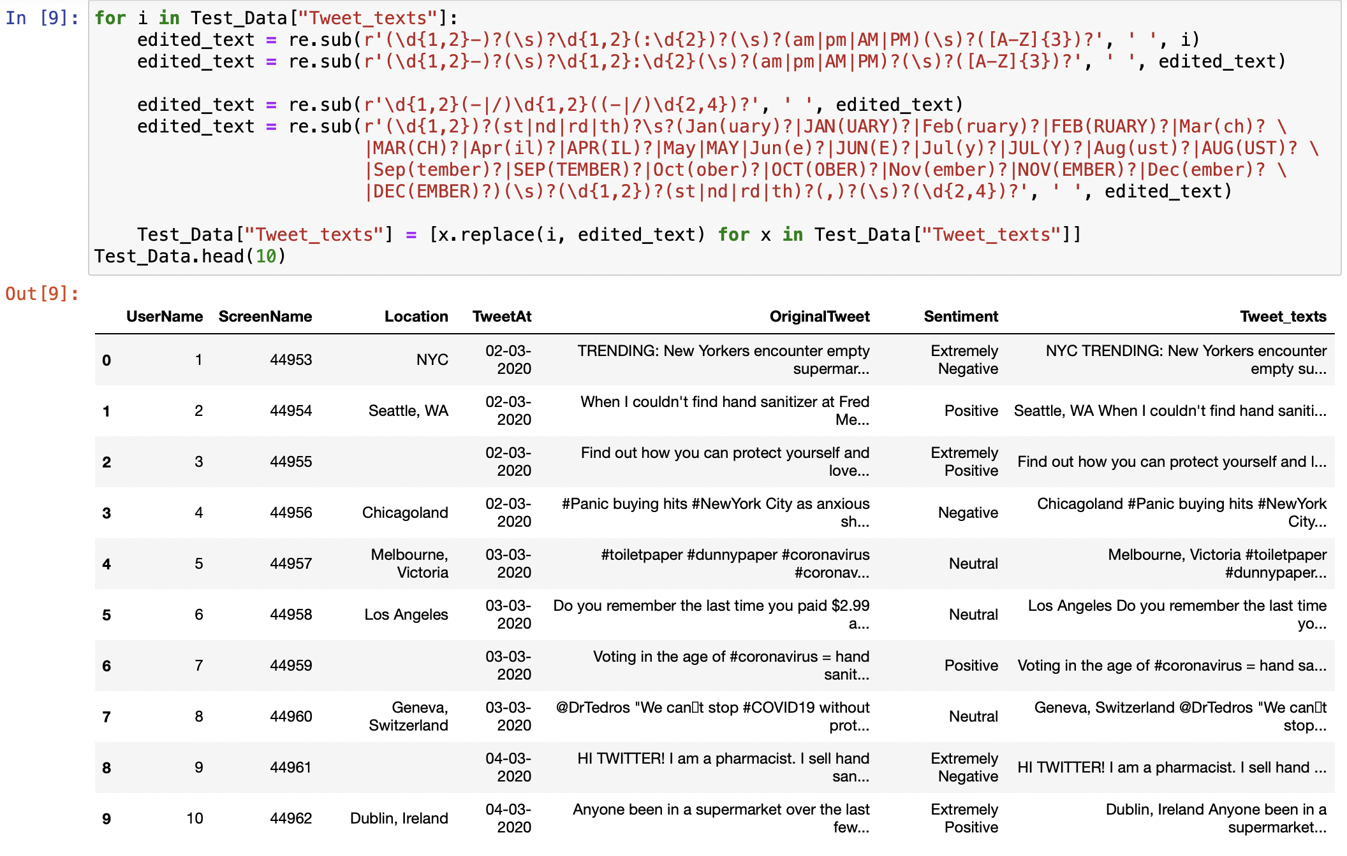
2. Clean and preprocess the new column of Tweet_texts: 2.1 Remove the date and time in the tweets using a regular expression.

Slide 9
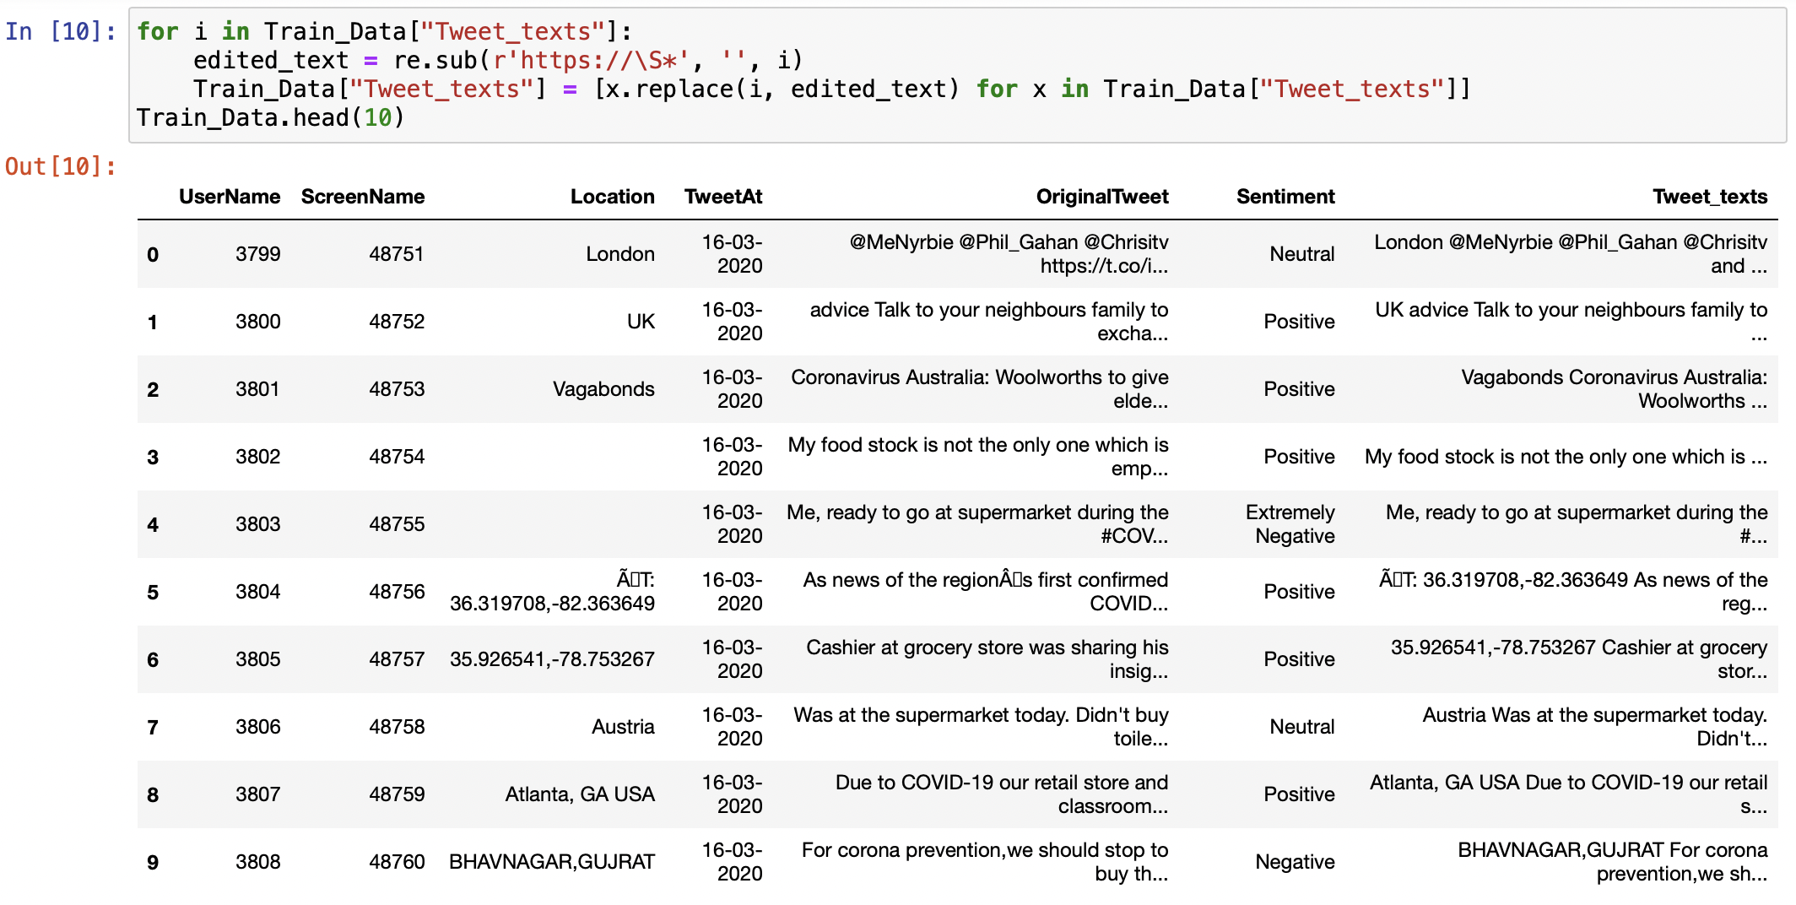
2.2 Remove the hyperlink URL in the tweets using a regular expression.

Slide 10
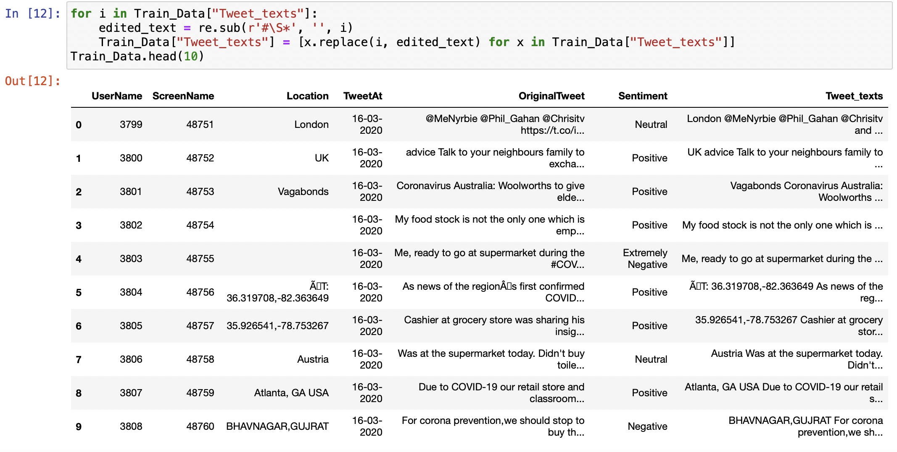
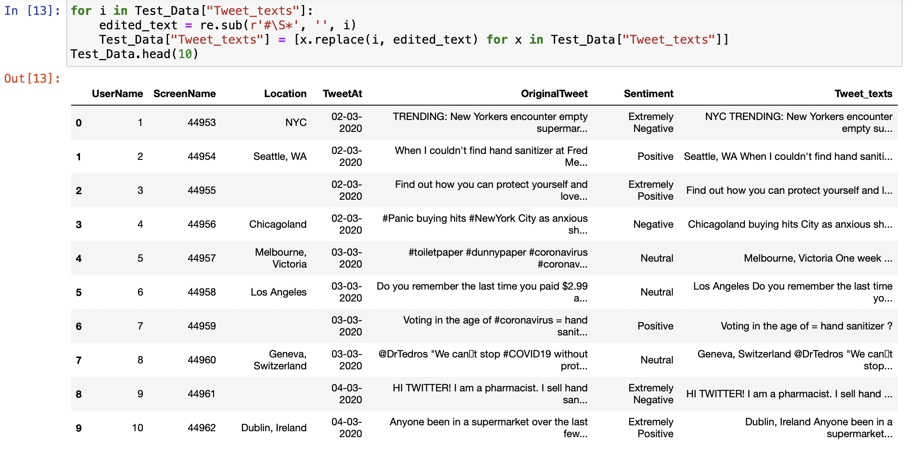
2.3 Remove the Twitter hashtags (# before a relevant keyword or phrase) in the tweets using a regular expression.

Slide 11
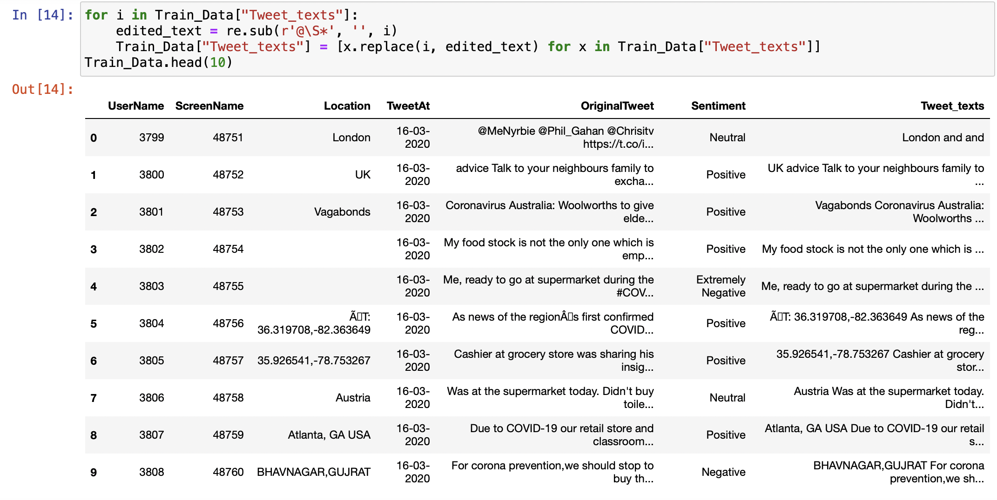

2.4 Remove the usernames (also known as the handle –– begins with the “@” symbol) using a regular expression.

Slide 12
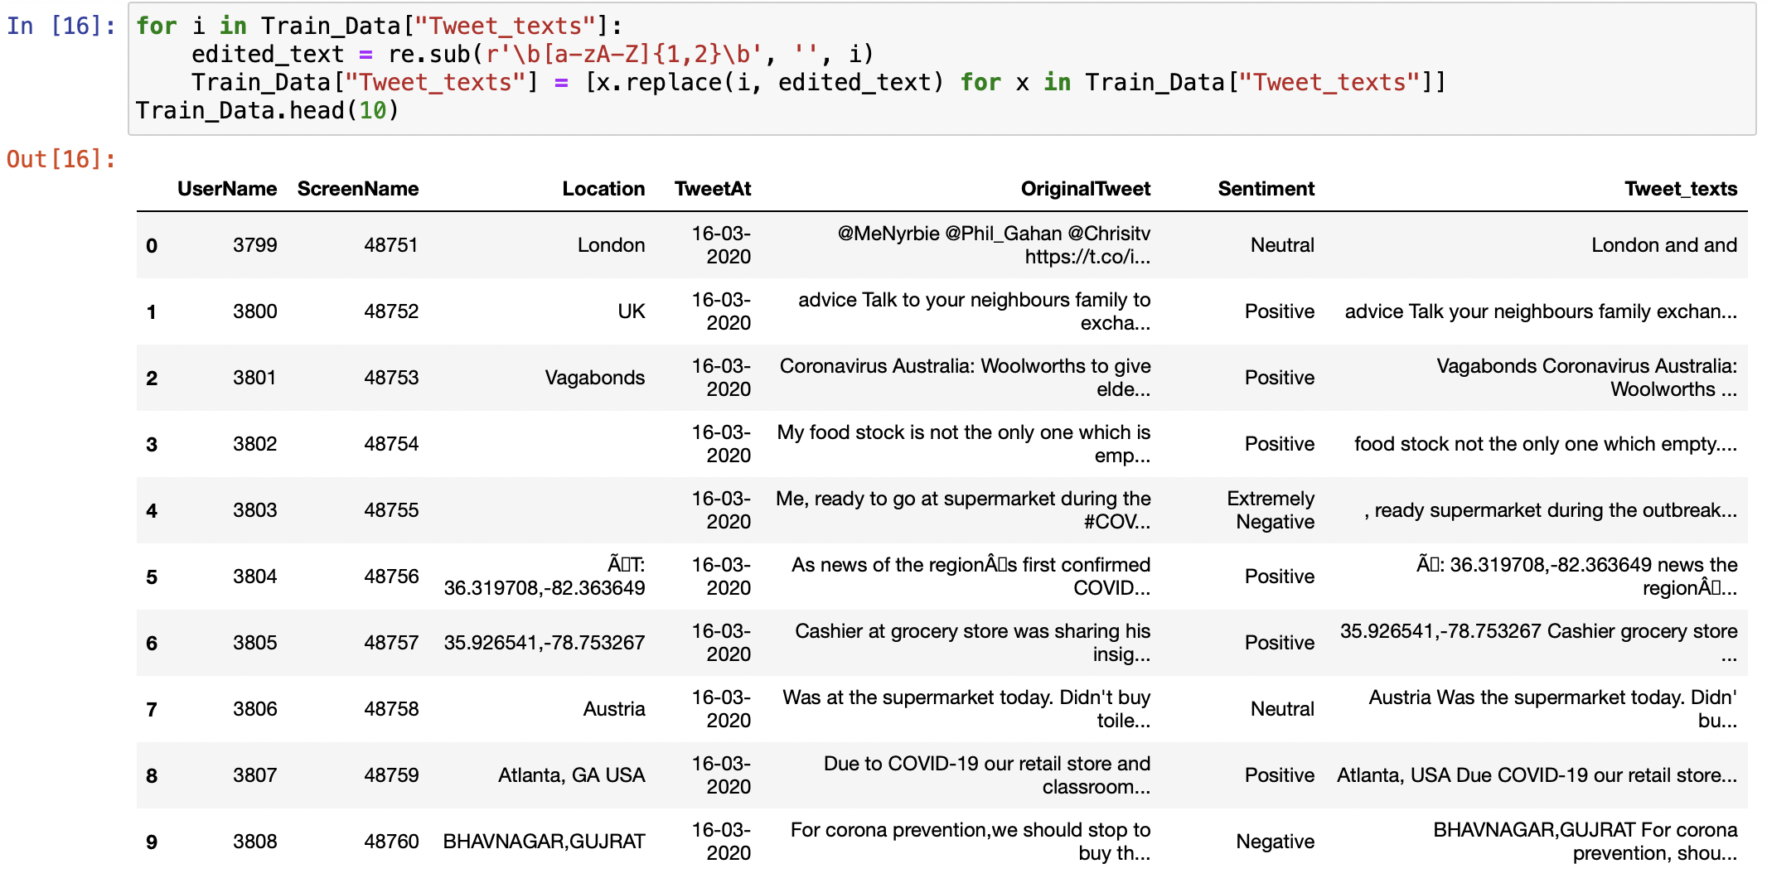
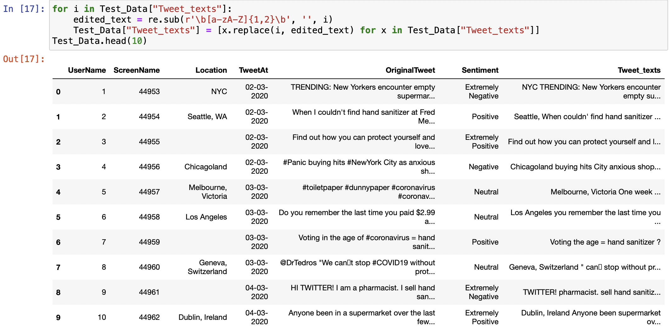
2.5 Remove all words containing at most two characters such as "a", "an", "in", "on", etc.

Slide 13
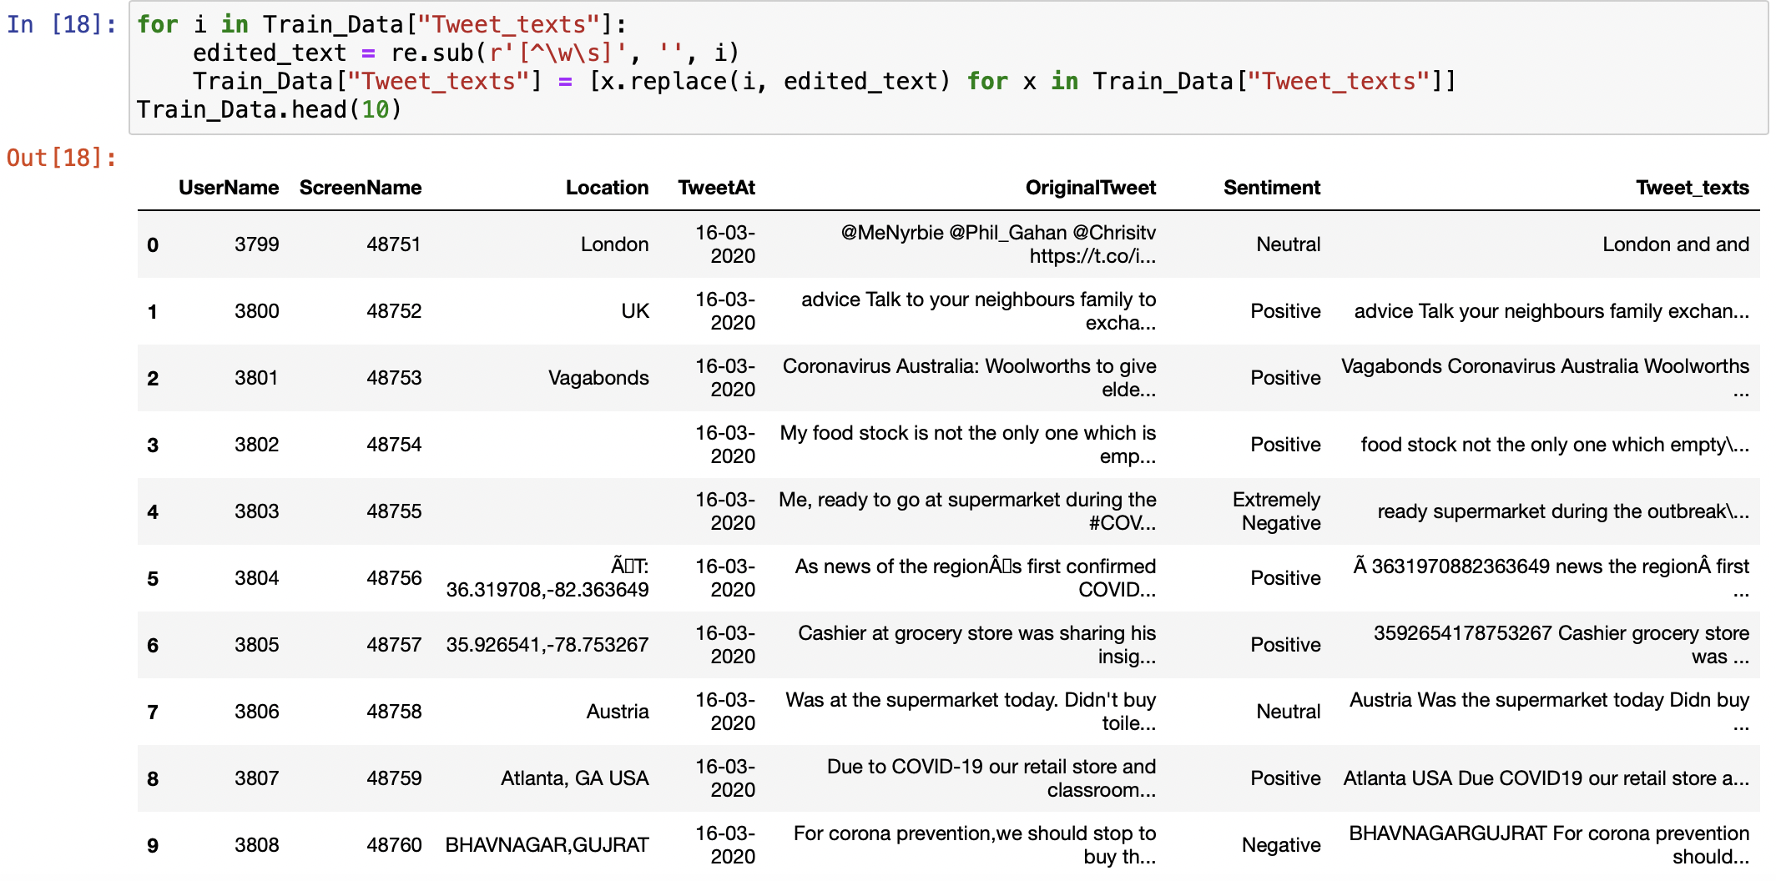
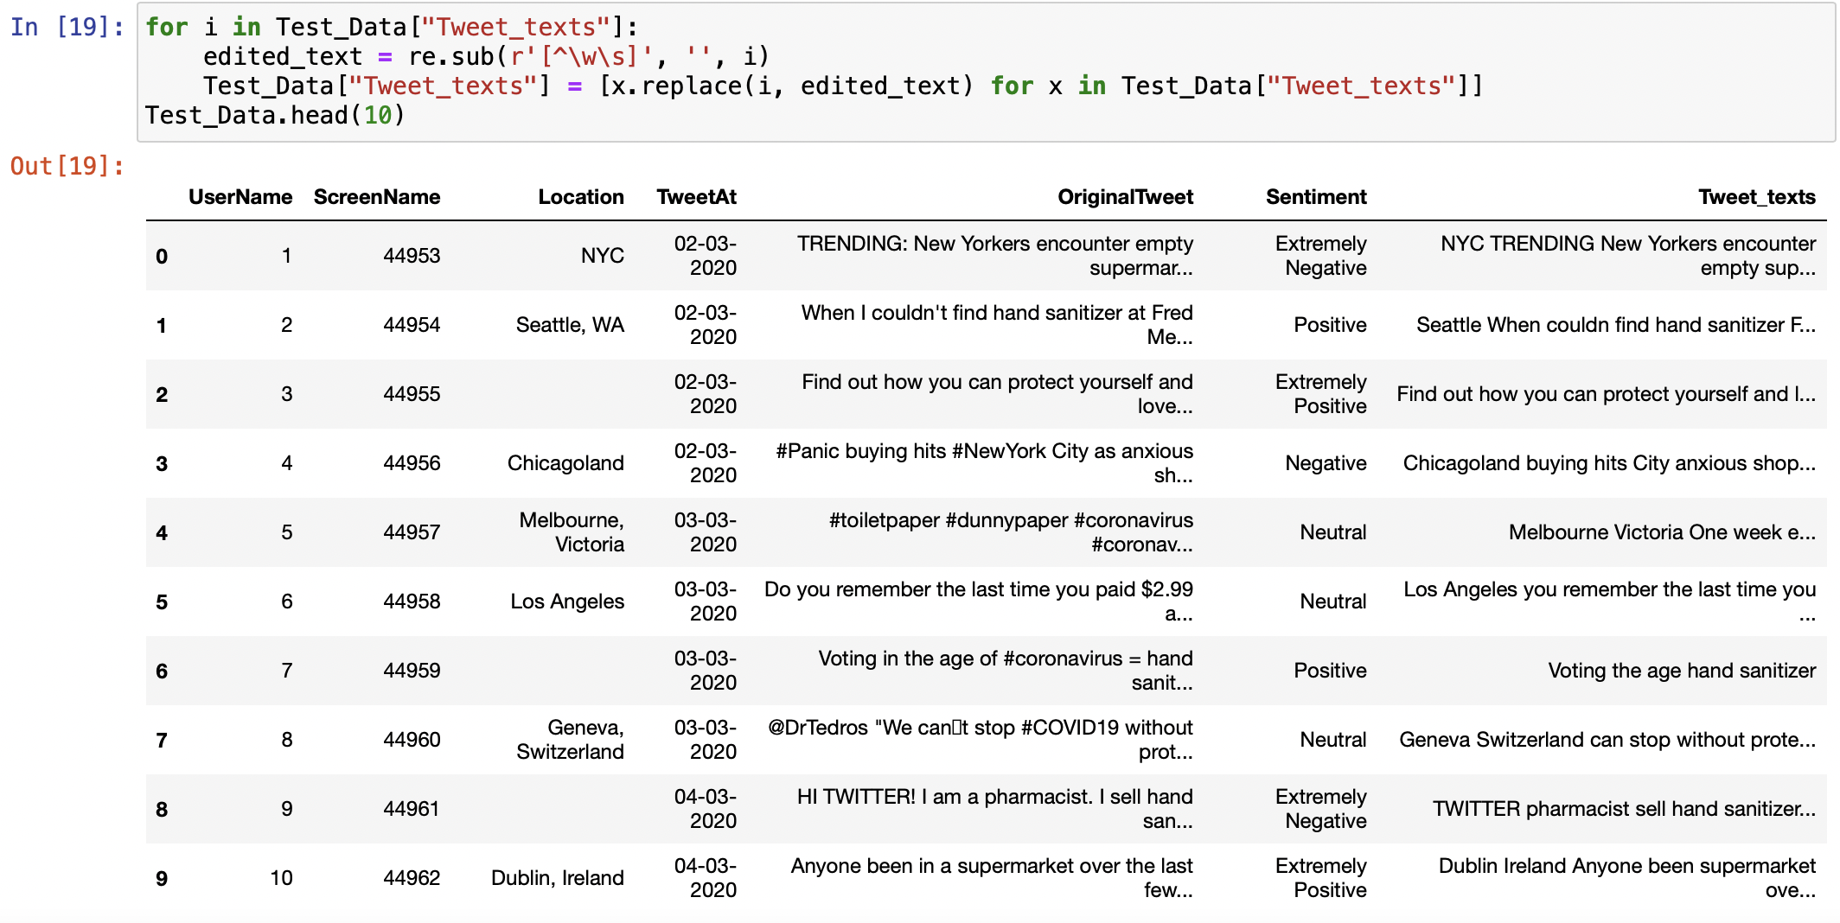
2.6 Remove all special characters, punctuation using a regular expression.

Slide 14
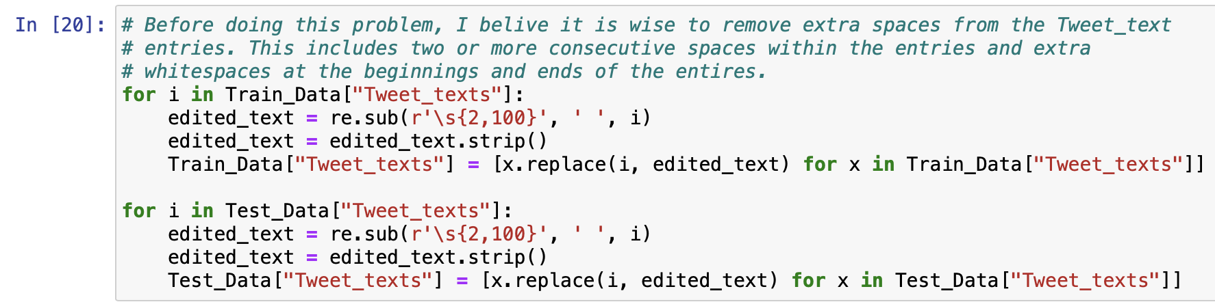
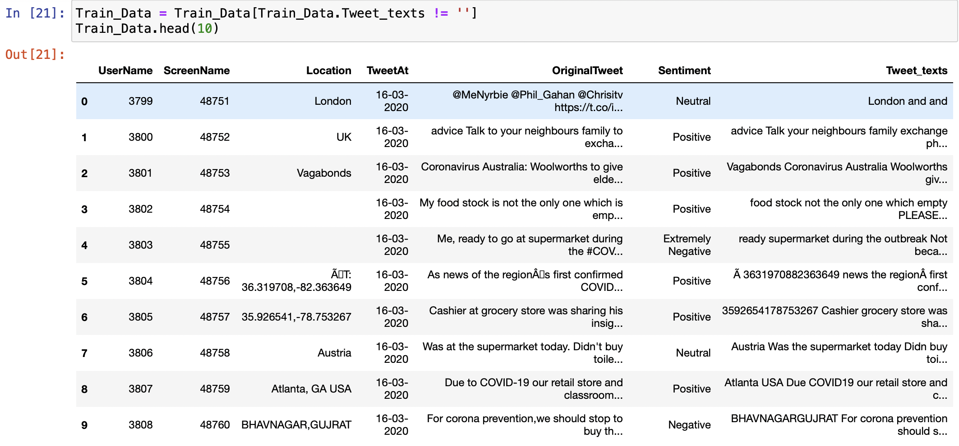
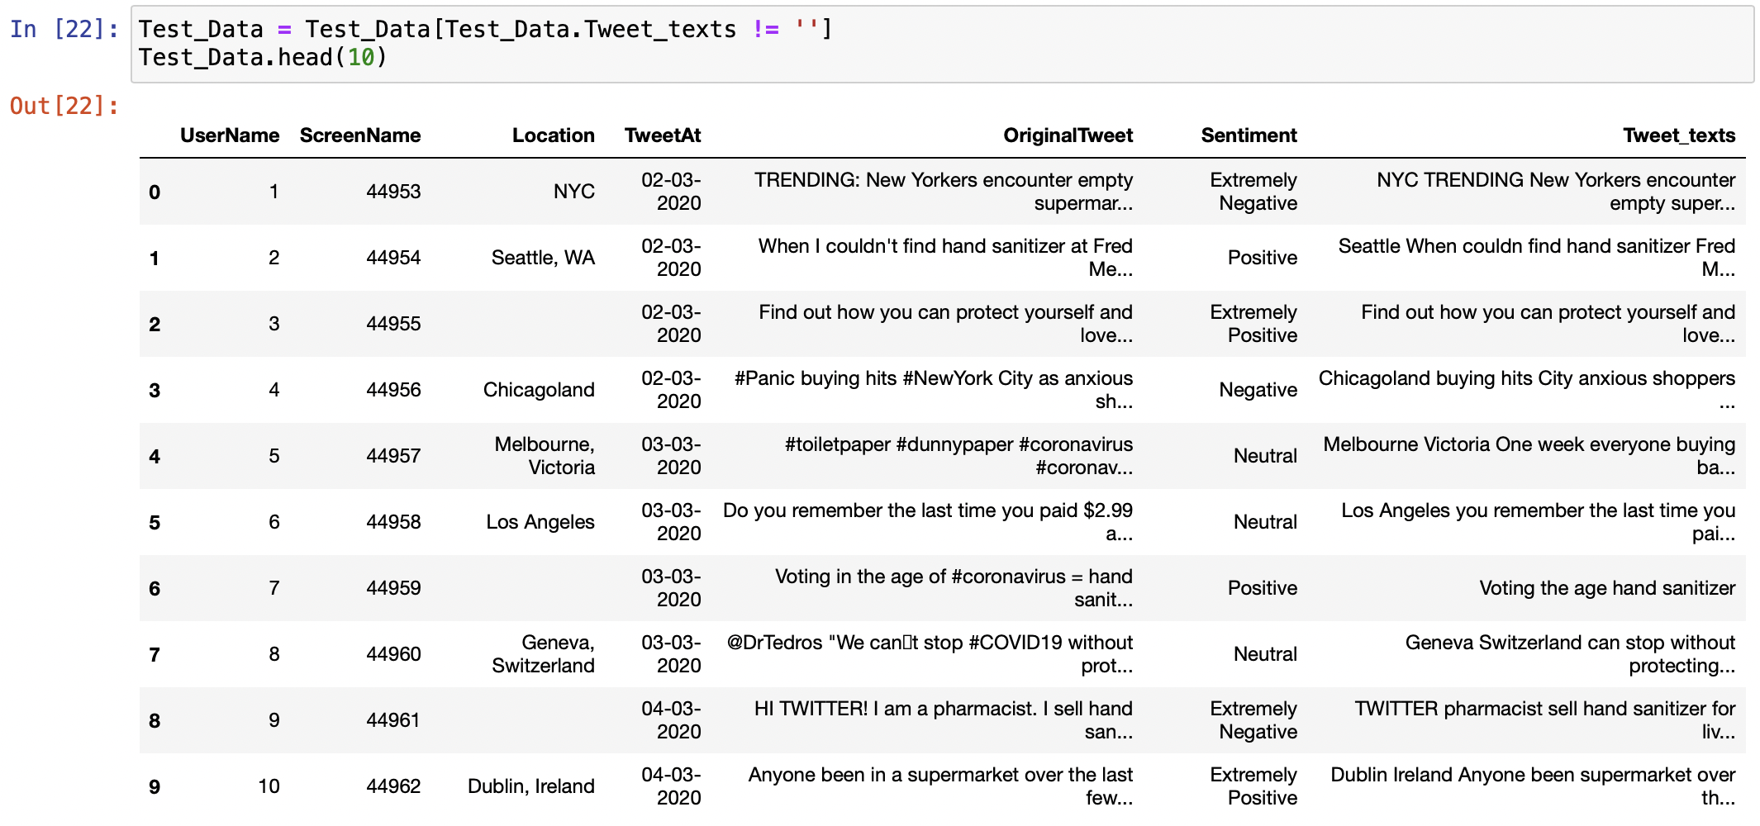
2.7 Remove all rows without any text left (empty text) in the column of Tweet_texts.

Slide 15
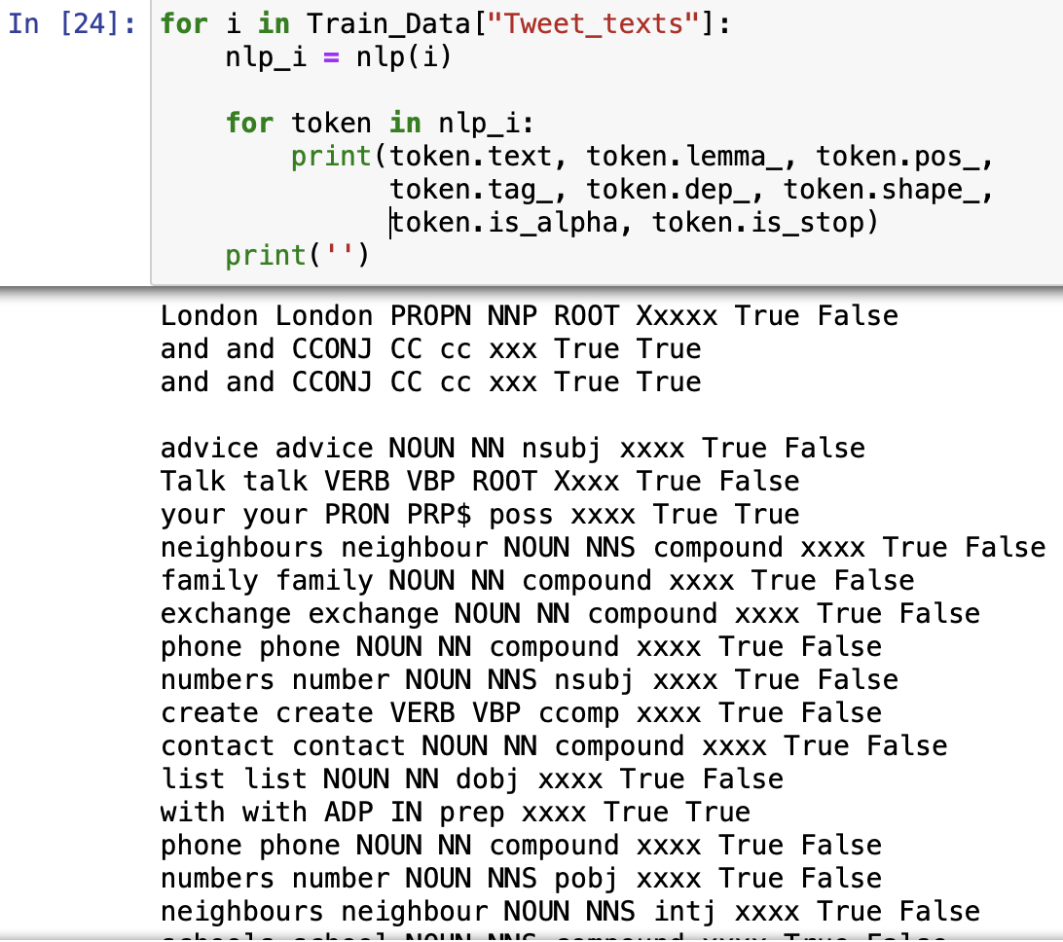
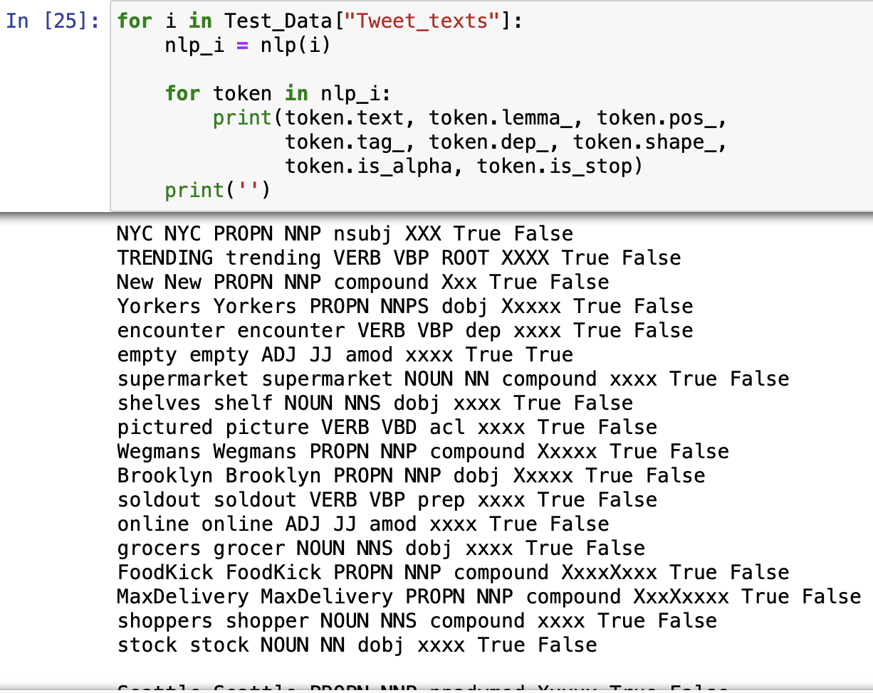
2.8 Perform the part of speech tagging for the texts.

Slide 16
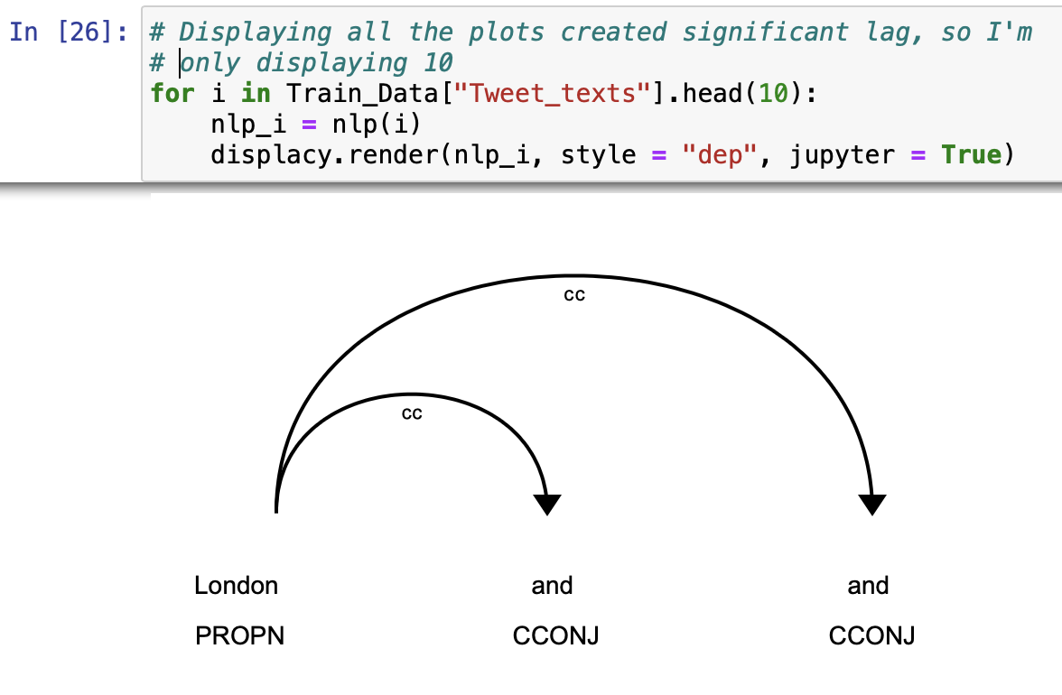
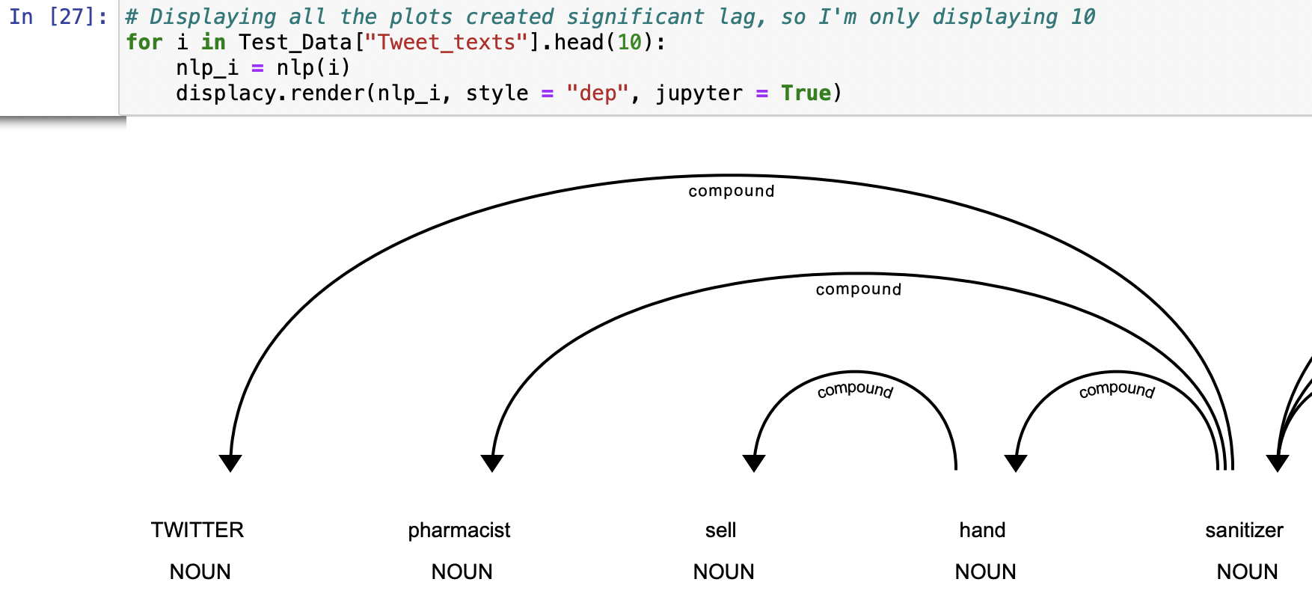
2.9 Visualize the dependency parser.

Slide 17
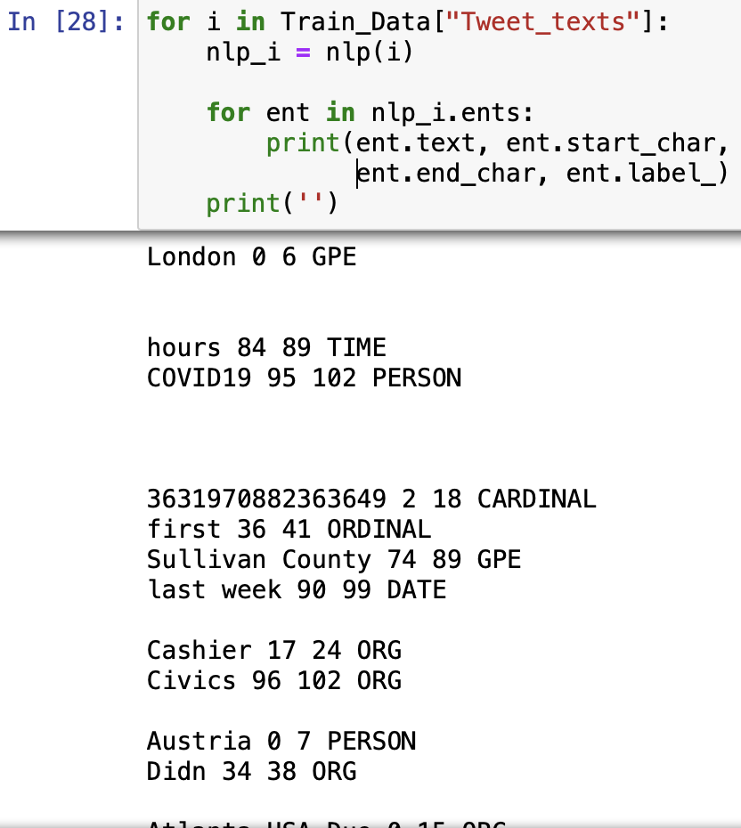
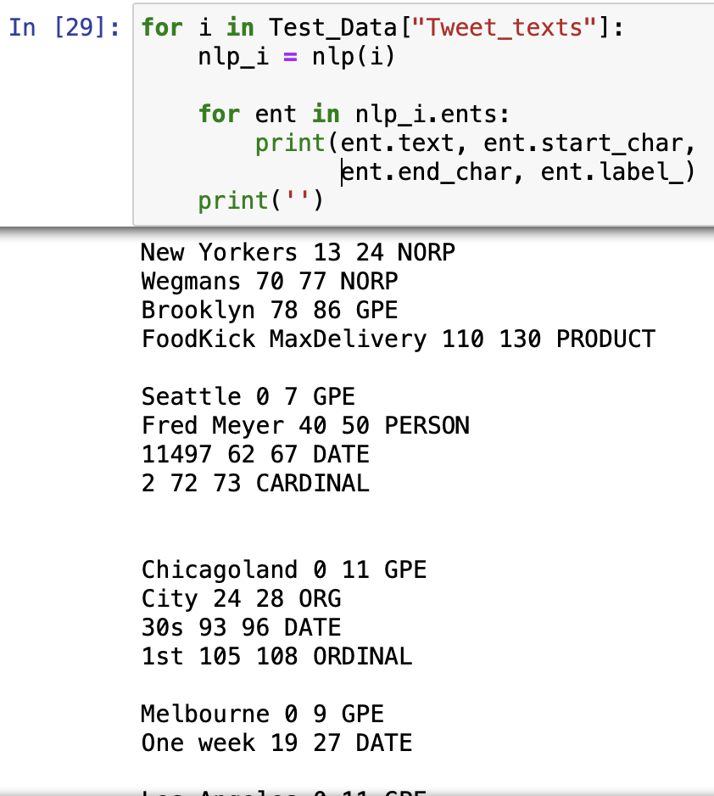
2.10 Perform the named entities recognition for the texts.

Slide 18
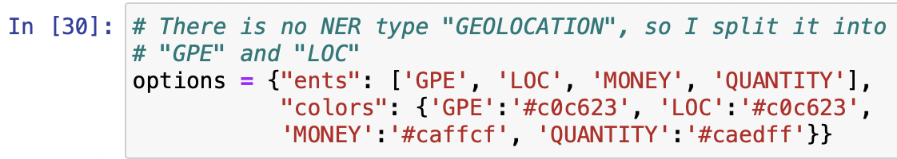
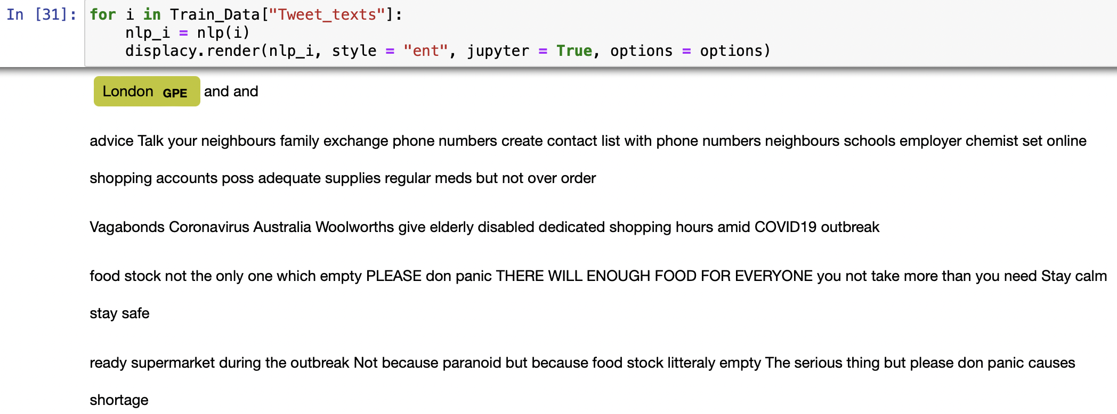
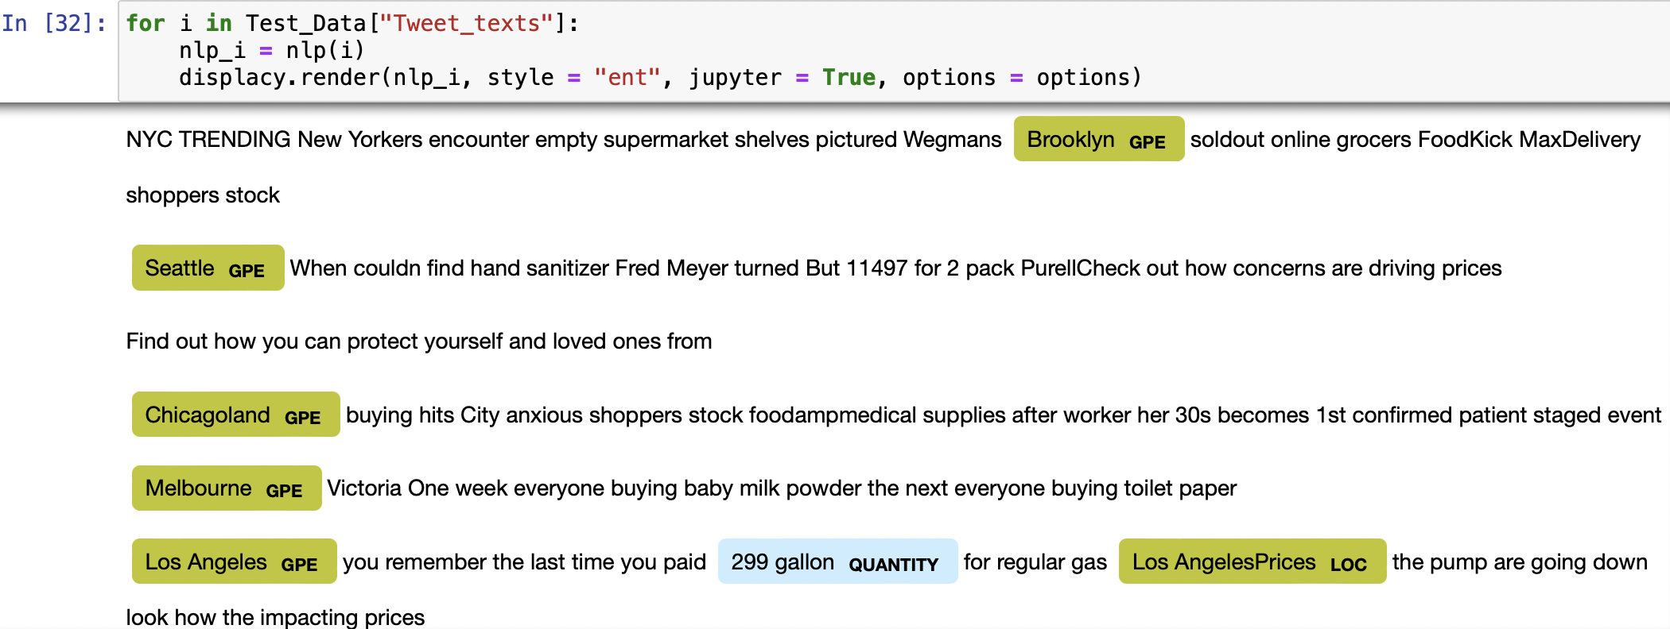
2.11 Visualize the GEOLOCATION, MONEY, and QUANTITY in the texts.

Slide 19
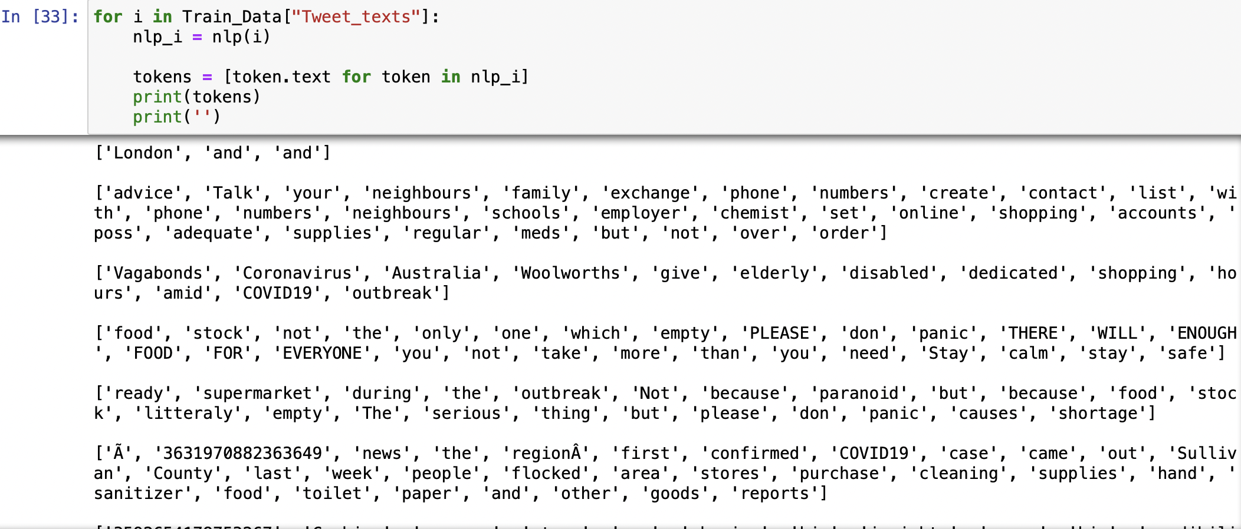
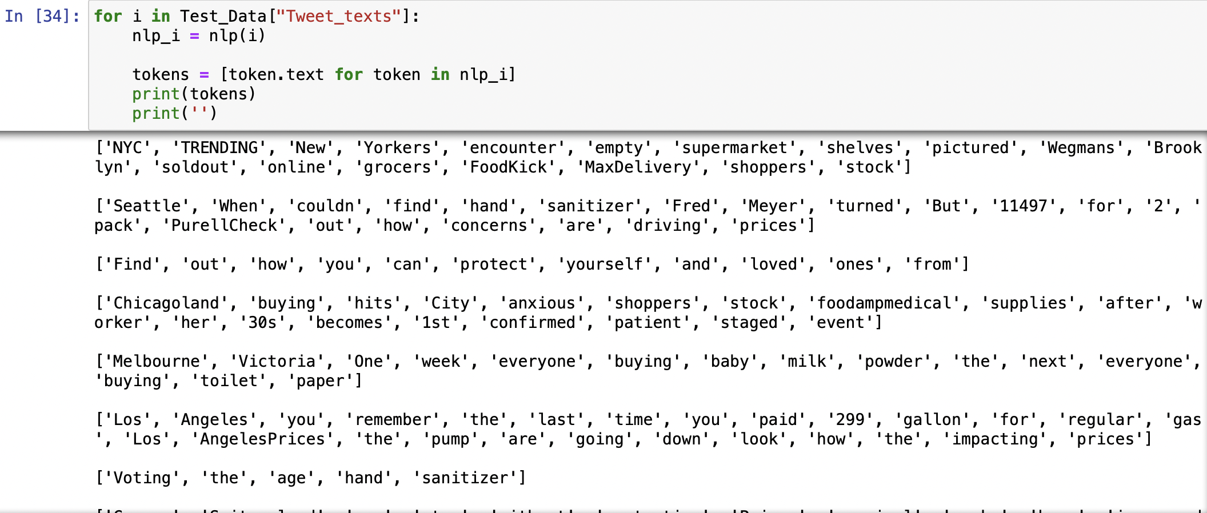
3. Extract all the tokens from the Tweet_texts.

Slide 20
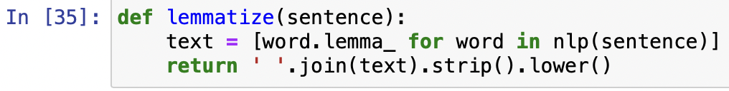
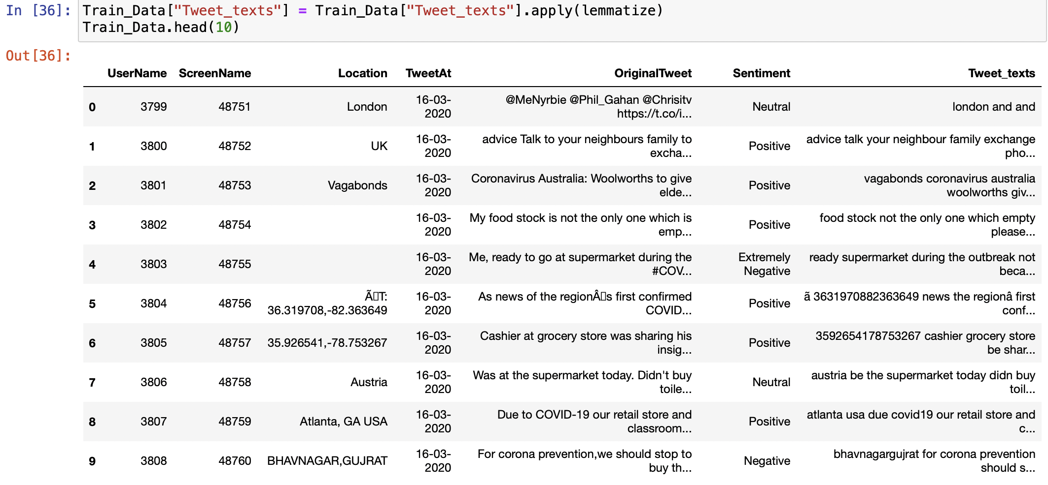
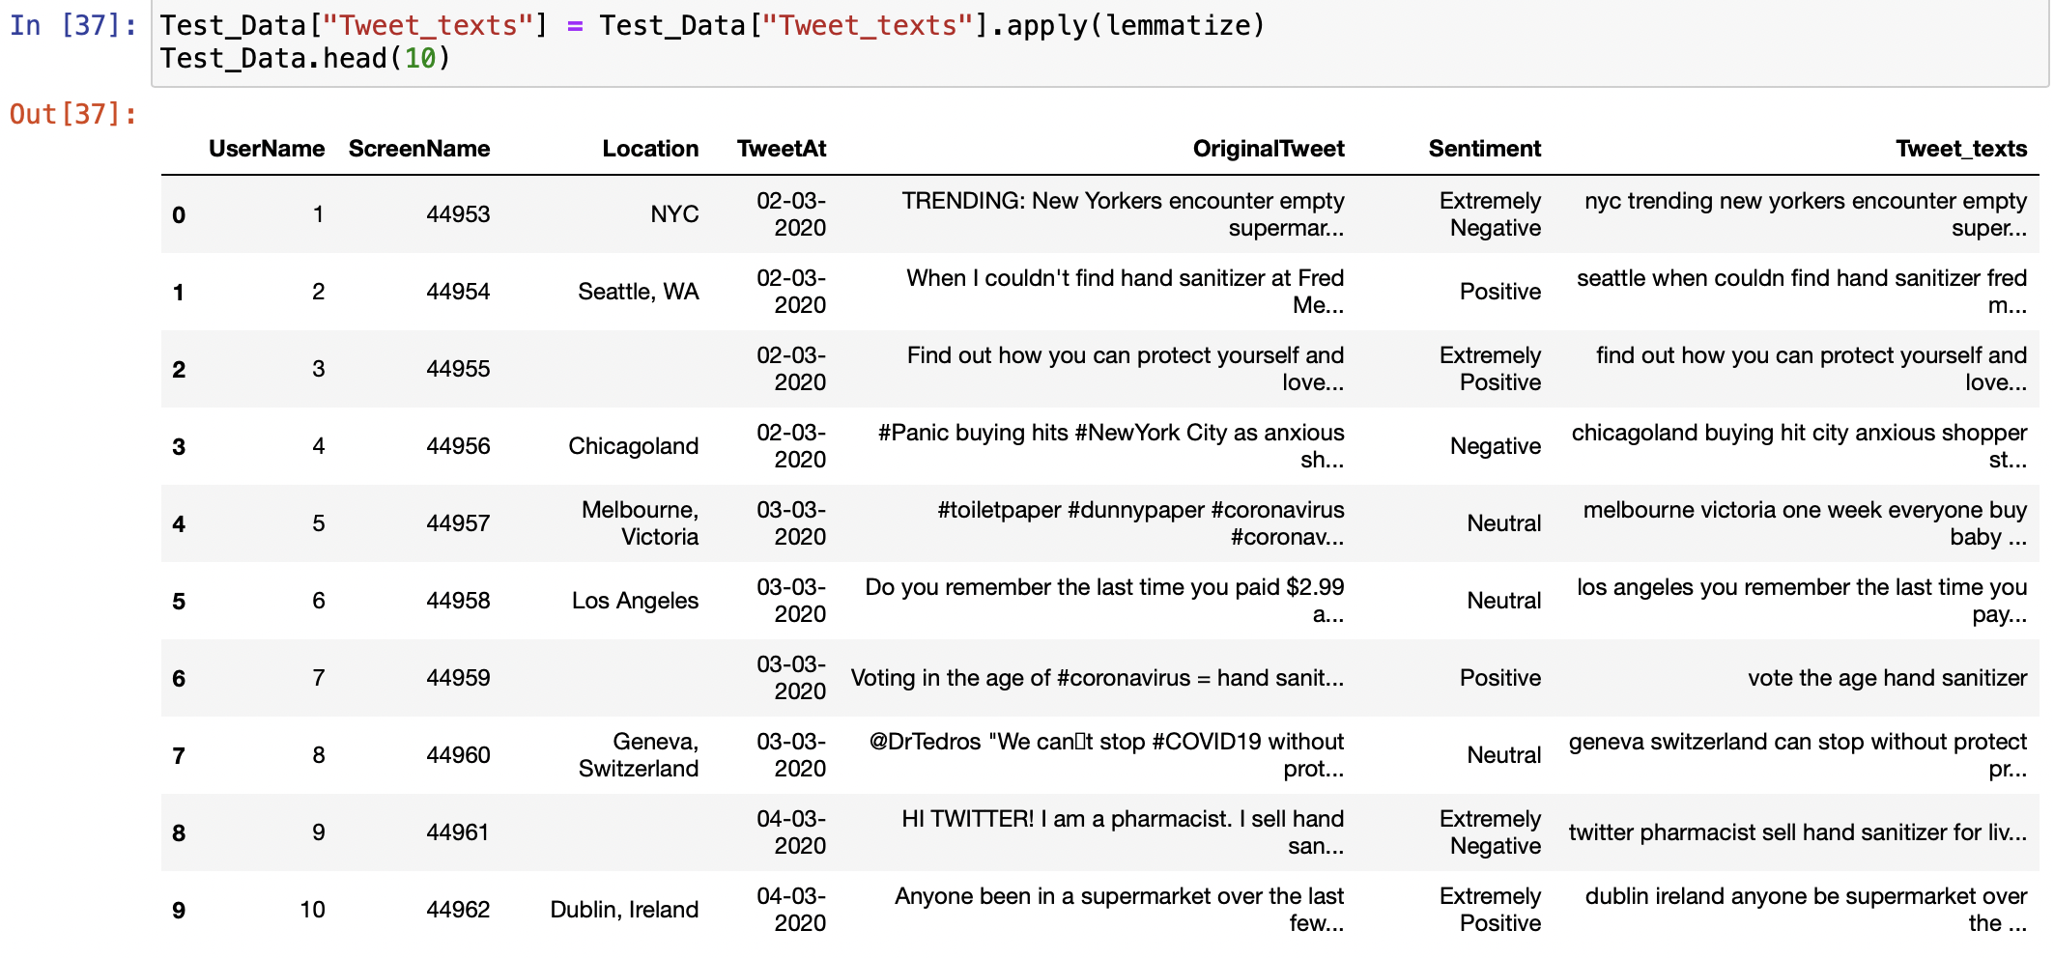
4. Replace the Tweet_texts column with the string only containing the lemmas of all the tokens.

Slide 21
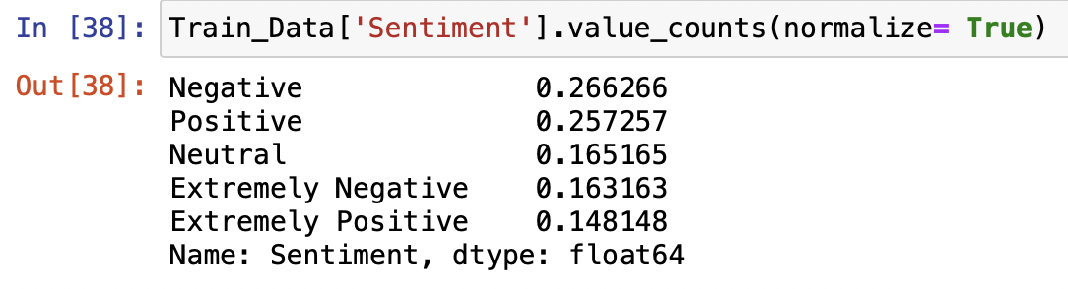
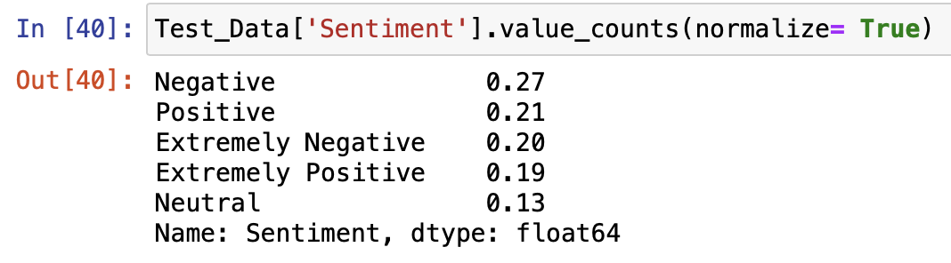
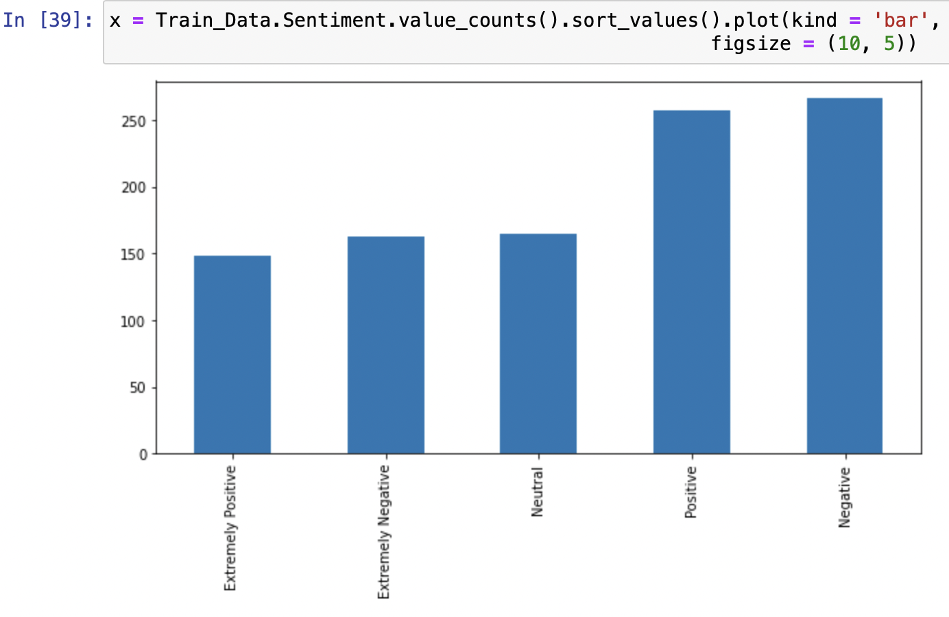
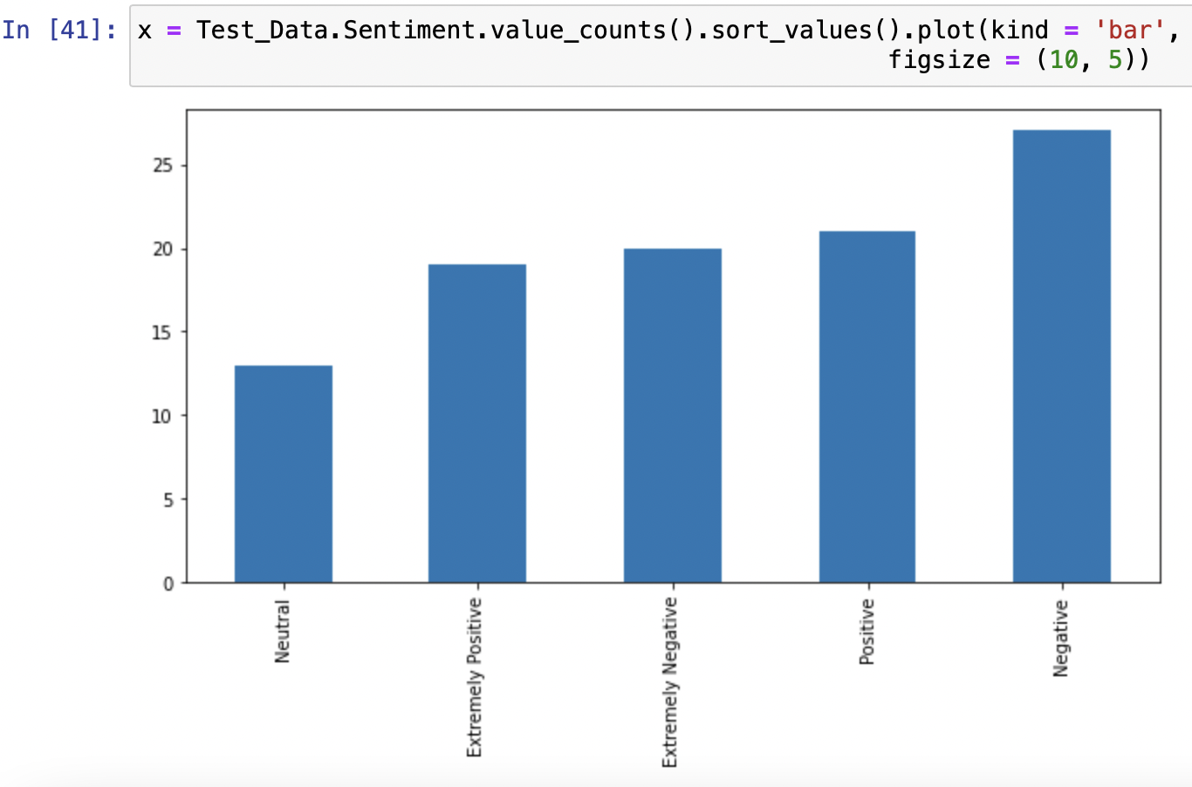
5. Graphically summarize the Sentiment.

Slide 22
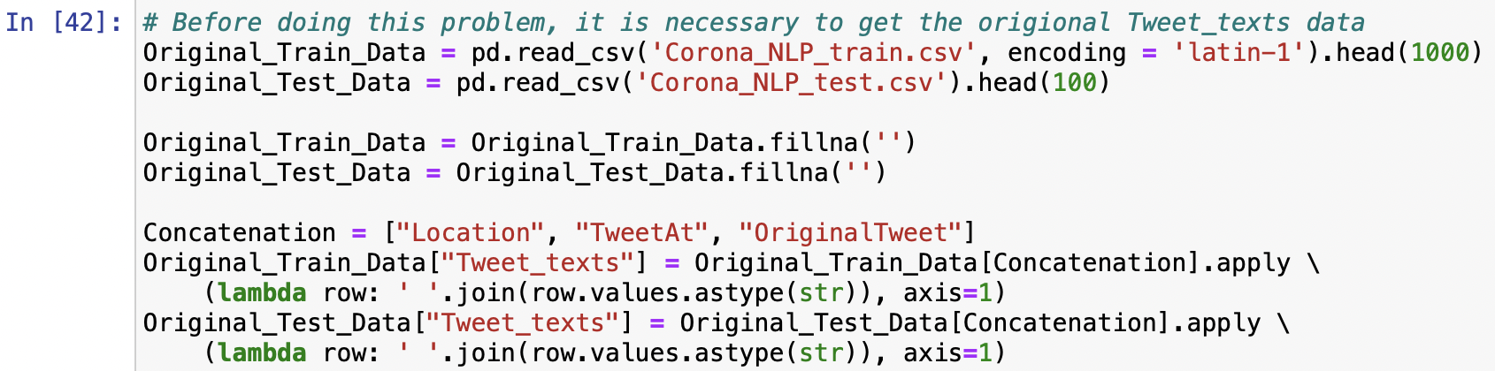
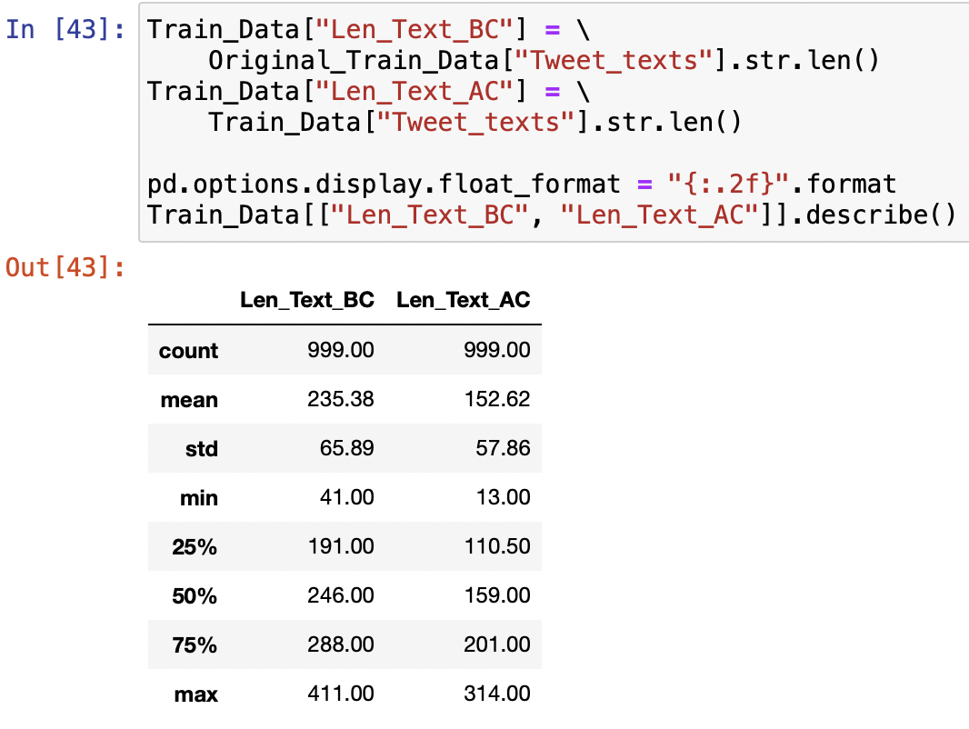
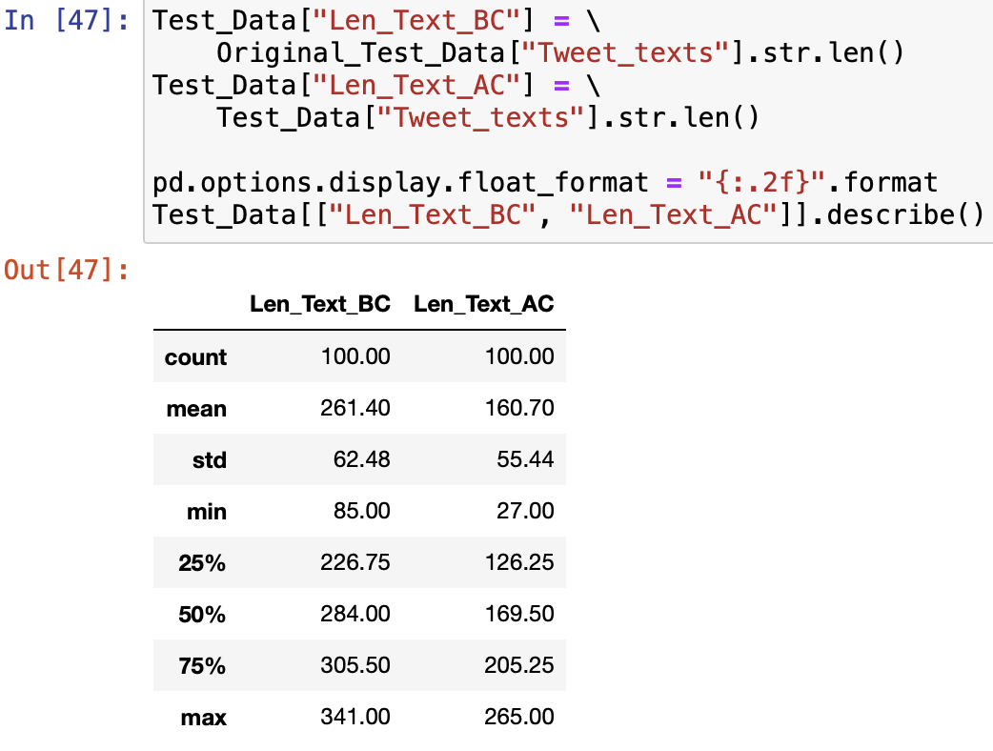
6. Graphically summarize the length of the text of the Tweet_texts using: - boxplot - histogram - density plot

Slide 23
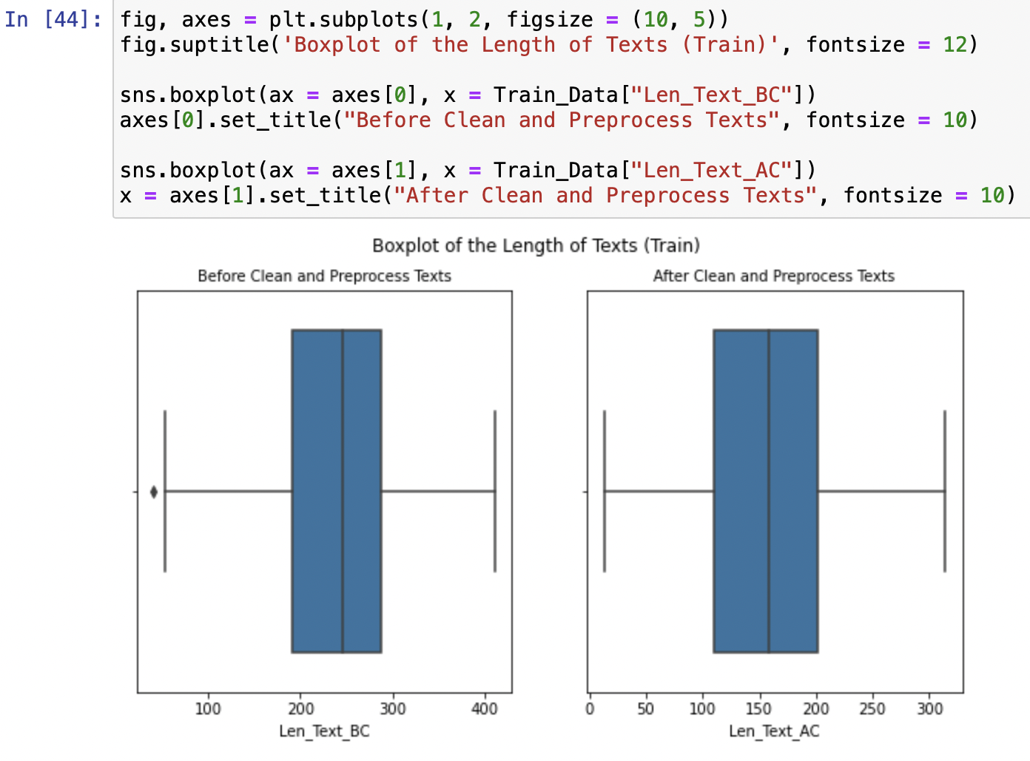
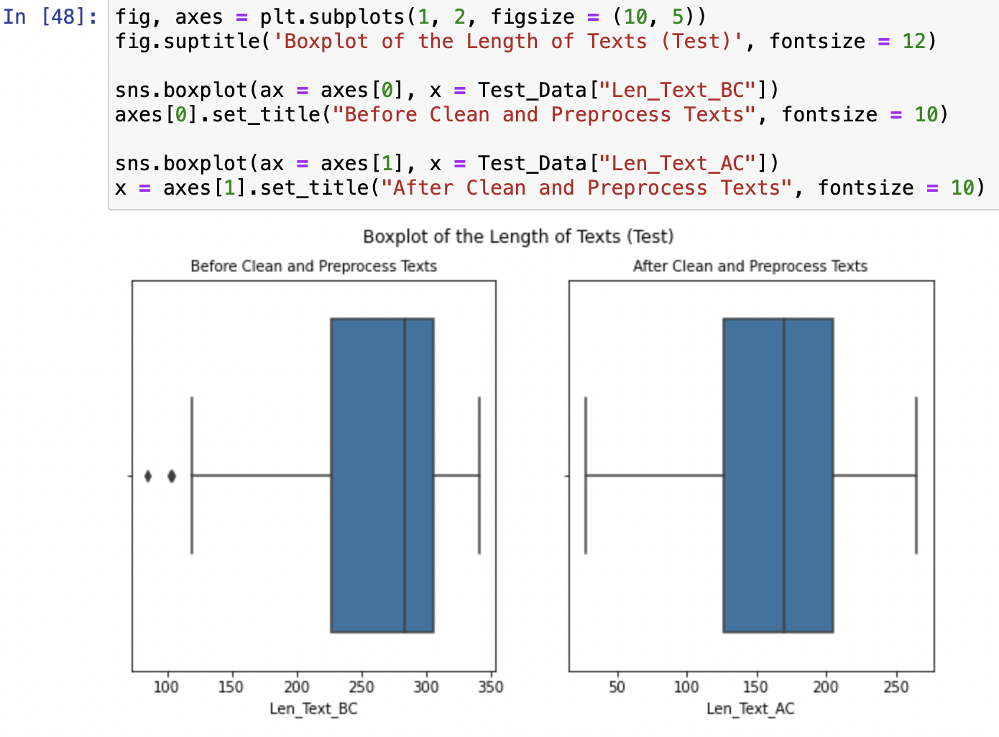
6. Graphically summarize the length of the text of the Tweet_texts using: - boxplot - histogram - density plot

Slide 24
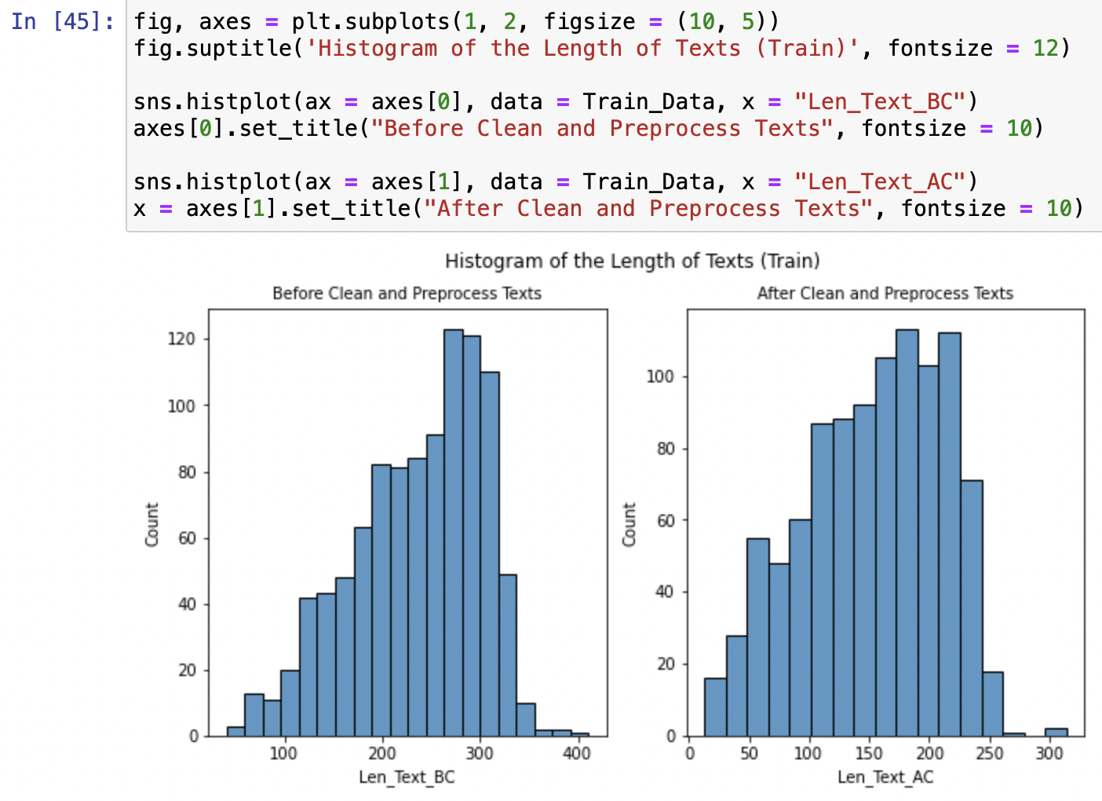
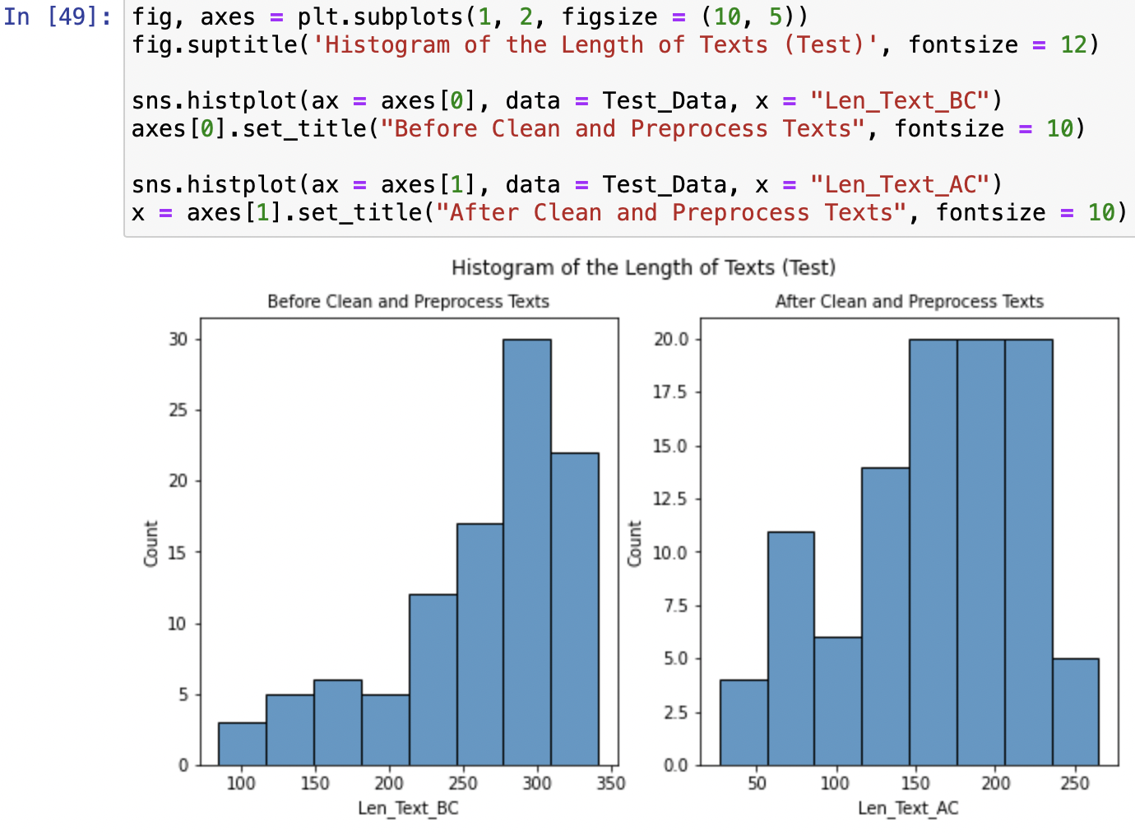
6. Graphically summarize the length of the text of the Tweet_texts using: - boxplot - histogram - density plot

Slide 25
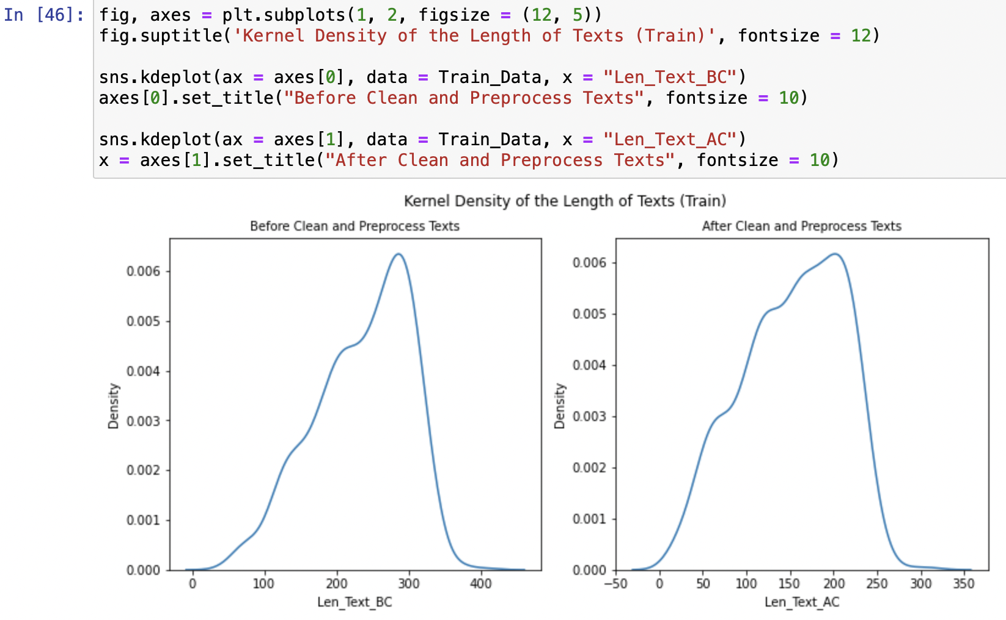
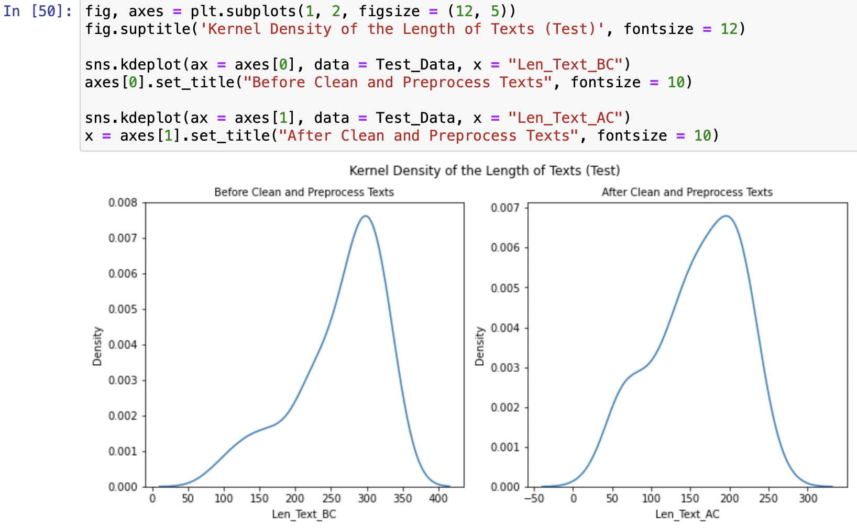
6. Graphically summarize the length of the text of the Tweet_texts using: - boxplot - histogram - density plot

Slide 26
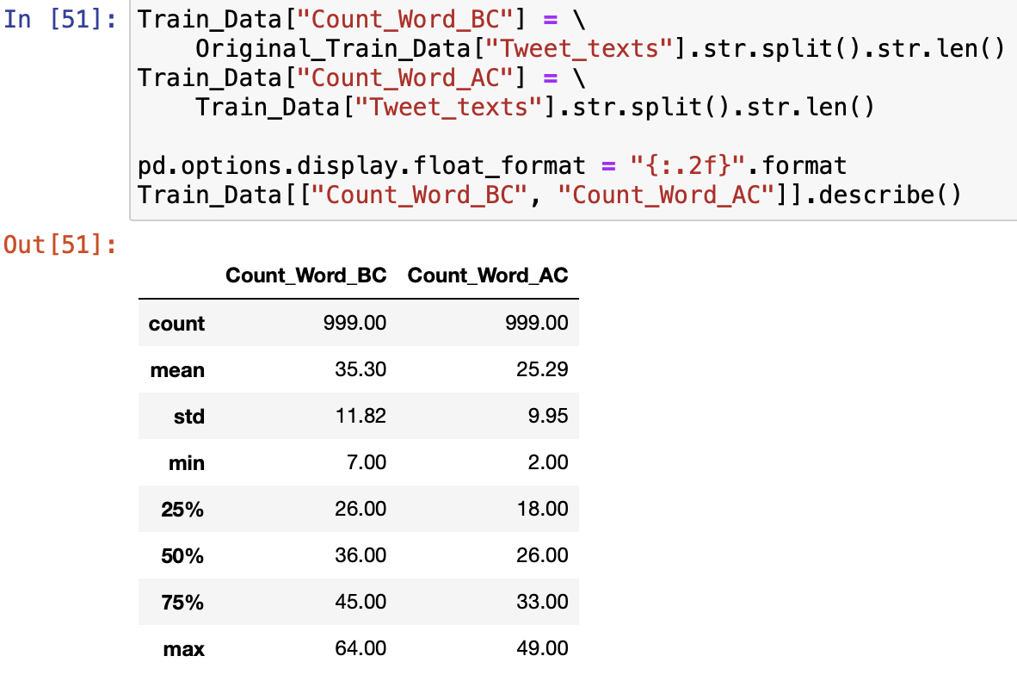
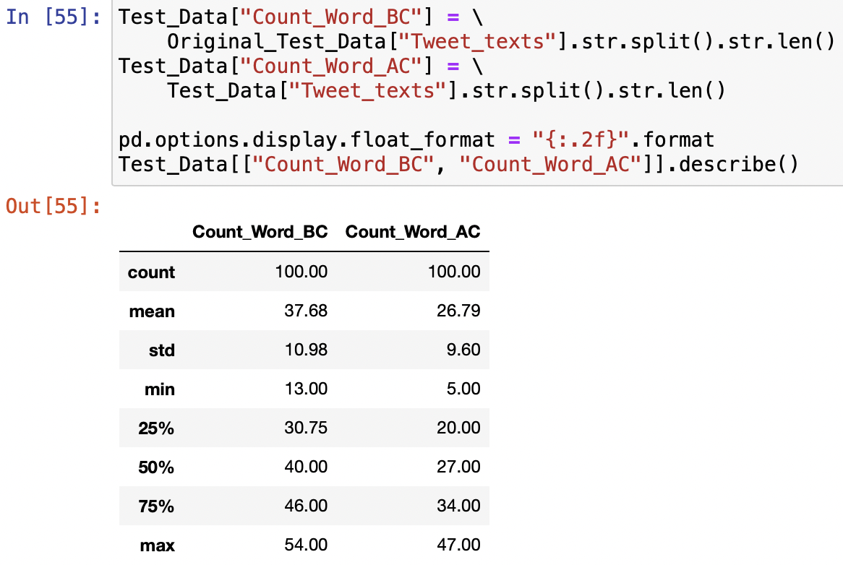
7. Graphically summarize the word count of the text of the Tweet_texts using: - boxplot - histogram - density plot

Slide 27
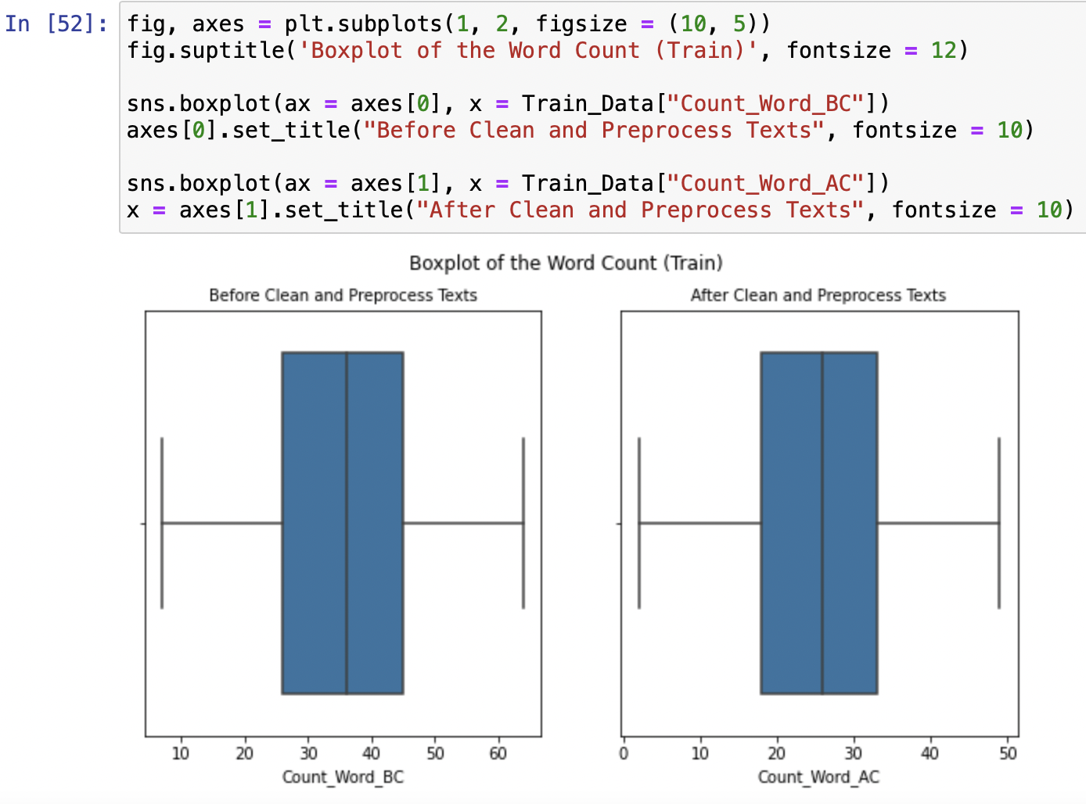

7. Graphically summarize the word count of the text of the Tweet_texts using: - boxplot - histogram - density plot

Slide 28


7. Graphically summarize the word count of the text of the Tweet_texts using: - boxplot - histogram - density plot

Slide 29


7. Graphically summarize the word count of the text of the Tweet_texts using: - boxplot - histogram - density plot

Slide 30

8. Graphically summarize the top 10 unigrams and bigrams of the tf-idf of the text of the Tweet_texts.

Slide 31



8. Graphically summarize the top 10 unigrams and bigrams of the tf-idf of the text of the Tweet_texts.

Slide 32



8. Graphically summarize the top 10 unigrams and bigrams of the tf-idf of the text of the Tweet_texts.

Slide 33



8. Graphically summarize the top 10 unigrams and bigrams of the tf-idf of the text of the Tweet_texts.

Slide 34



8. Graphically summarize the top 10 unigrams and bigrams of the tf-idf of the text of the Tweet_texts.

Slide 35


9-10. Visualize the top 10 Term Frequency and positive scores of the tokens associated with positive tweets using scattertext.

Slide 36


9-10. Visualize the Top 10 Term Frequency and Positive Scores of the Tokens Associated with Positive Tweets Using Scattertext.

Slide 37


9-10. Visualize the Top 10 Term Frequency and Positive Scores of the Tokens Associated with Positive Tweets Using Scattertext.

Slide 38


9-10. Visualize the Top 10 Term Frequency and Positive Scores of the Tokens Associated with Positive Tweets Using Scattertext.

Slide 39


9-10. Visualize the Top 10 Term Frequency and Positive Scores of the Tokens Associated with Positive Tweets Using Scattertext.

Slide 40


9-10. Visualize the Top 10 Term Frequency and Positive Scores of the Tokens Associated with Positive Tweets Using Scattertext.

Slide 41


9-10. Visualize the Top 10 Term Frequency and Positive Scores of the Tokens Associated with Positive Tweets Using Scattertext.

Slide 42



11. Convert the column of the Tweet_texts to a matrix of token counts using CountVectorizer and unigrams and bigrams.

Slide 43


12. Perform the tf-idf analysis on the column of the Tweet_texts using Tfidfvectorizer.

Slide 44


13. Find the cosine similarity in Tweet_texts between the 200th and 20,000th tweets.

Slide 45

14. Find the corpus vector equal to the average of all the document vectors, where each document corresponds to a tweet or a row in this dataset.

Slide 46


15. Build the first model based on the training dataset using the random forests and pipeline.

Slide 47


15. Build the first model based on the training dataset using the random forests and pipeline.

Slide 48


15. Build the first model based on the training dataset using the random forests and pipeline.

Slide 49


15. Build the first model based on the training dataset using the random forests and pipeline.

Slide 50

15. Build the first model based on the training dataset using the random forests and pipeline.

Slide 51

16. Check the first model on the test dataset. Is it a good model based on the selected evaluation metrics? Please justify your answer.

Slide 52


17. Create the second model using random forest, pipeline, grid search CV for the hyperparameters for the estimators.

Slide 53

18. Tune the second model and perform model diagnostics on the test dataset. Is it a good model? Please justify your answer.

Slide 54


18. Tune the second model and perform model diagnostics on the test dataset. Is it a good model? Please justify your answer.

Slide 55


18. Tune the second model and perform model diagnostics on the test dataset. Is it a good model? Please justify your answer.

Slide 56

19. Build the third model using pipeline, grid search CV, hyperparameter for the following classifiers: - Logistic Regression - Support Vector Machine - Random Forest

Slide 57


19. Build the third model using pipeline, grid search CV, hyperparameter for the following classifiers: - Logistic Regression - Support Vector Machine - Random Forest

Slide 58

19. Build the third model using pipeline, grid search CV, hyperparameter for the following classifiers: - Logistic Regression - Support Vector Machine - Random Forest

Slide 59

20. Tune the third model and perform model diagnostics on the test dataset. Is it a good model? Please justify your answer.

Slide 60


20. Tune the third model and perform model diagnostics on the test dataset. Is it a good model? Please justify your answer.

Slide 61


20. Tune the third model and perform model diagnostics on the test dataset. Is it a good model? Please justify your answer.

Slide 62

21. Generate the first topic model by setting five topics using LDA method and CountVectorizer.

Slide 63


22. Plot the top 15 words for each topic for the model above.

Slide 64

22. Plot the top 15 words for each topic for the model above.

Slide 65

23. Generate the second topic model by setting five topics using LDA method and TfidfVectorizer.

Slide 66


24. Plot the top 15 words for each topic for the second model above.

Slide 67


25. Visualize the second topic model using the dimension reduction method.

Slide 68
Questions?

